Slide 1
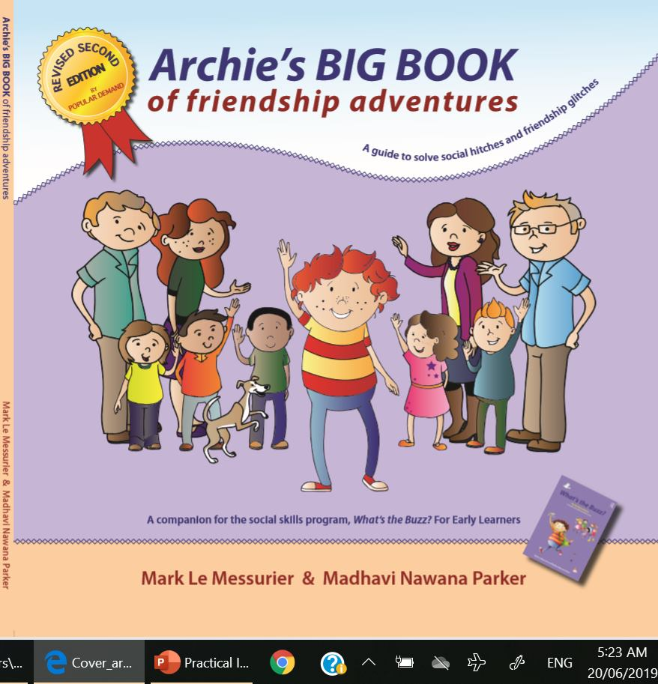

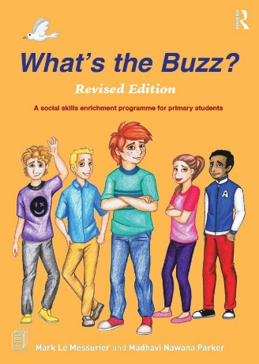
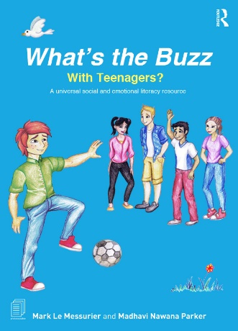
Welcome back!
‘Archie’s BIG BOOK of Friendship Adventures’ ( Revised Edition, 2023) companions,
What’s the Buzz? For Early Learners
‘What’s the Buzz?’ (2023) –
For Early Learners
SECOND EDITION
‘What’s the Buzz? (2019) –
with TEENAGERS?
‘What’s the Buzz? (2019)–
Revised Edition for PRIMARY Students
The slides and notes can be collected from
https://whatsthebuzz.net.au/main-menu/free-downloads-and-resources
Notes:
MARK
Welcome back.
Between now and lunch (lunch is at 1pm) …
We’ll glimpse each of the 3 ‘What’s the Buzz?’ programs – just so you have a context.
Noni will introduce you to our neuroaffirming principles for groupwork, and she’ll give you an insight into her teen and young adult BUZZ groups.
Finally, in the hour before lunch, we’ll immerse you in a demo lesson, revised edition
It’s Lesson 13 - from ‘What’s the Buzz? for EARLY LEARNERS - Speaking up (learning to be assertive)

Slide 2

Notes:
MARK
So, when is ‘What’s the Buzz?’ most likely to succeed?
Firstly, when running the program in a regular classroom, it’s handy to have a school support officer with you.
It means one has the freedom to teach while the other reinforces the behaviours we value.
When we put together a targeted group of students, we attempt to connect kids who are likely to form a bond, enjoy one another’s company and create an optimal learning environment.
Targetted groups follow 2 rules –
Up to 4 students in a group with one facilitator
Or up to 8 students when run by 2 facilitators
Finally, always remember to read the introduction to the manual you are using!

Slide 3
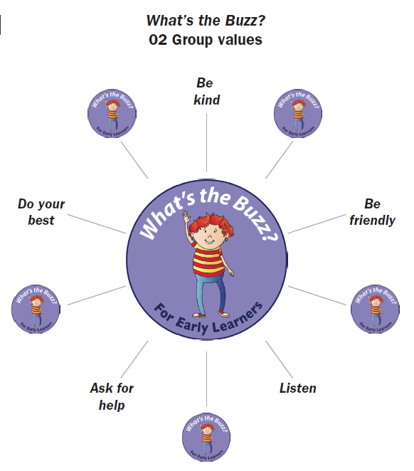
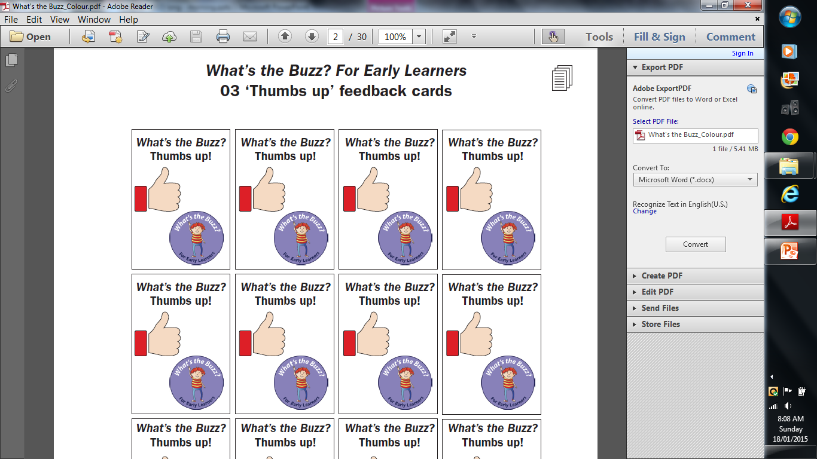
Notes:
MARK
In our EL and PRIMARY groups, we use feedback cards (you can see them on screen) to give continuous feedback to each group member.
The stream of ‘feedback cards’ indicates their behaviour is working for THEM, and for OTHERS in the group.
You can see our group values on screen.
They focus on thoughtful group behaviours.
We display the Group Values where everybody can see them.
Often, we spend a moment or two drawing everyone’s attention to them because group work and the necessary community skills are tough for some of our kids.
Let me leap into a quick OVERVIEW of the 3 books that make program

Slide 4
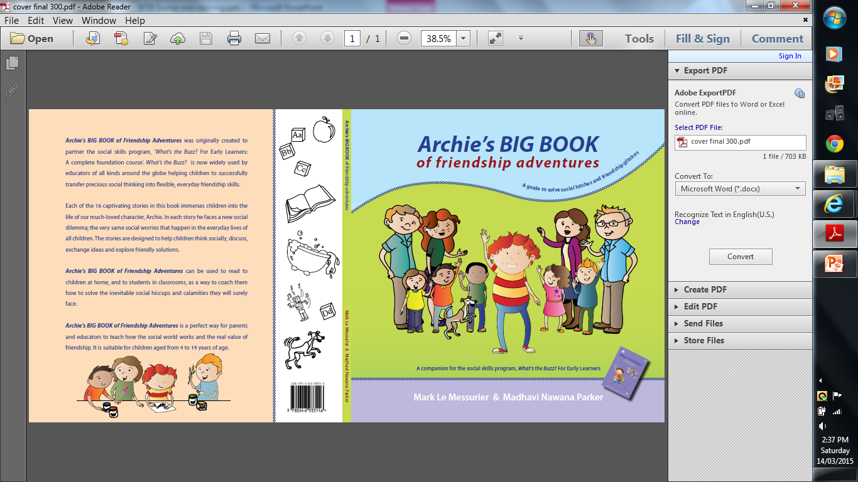
‘What’s the Buzz?’ for EARLY LEARNERS
16 lessons
Each lesson can be taught in its entirety, or in smaller convenient parts
’What’s the Buzz?’ for EARLY LEARNERS (2023) ages 4 to 8 years
SECOND EDITION
A companion to the EARLY LEARNERS;
Archie’s BIG BOOK of Friendship Adventures
Notes:
MARK
First up, there’s - ‘What’s the Buzz? for EARLY LEARNERS
It’s for our youngest.
Archie’s BIG BOOK of Friendship Adventures accompanies the EARLY LEARNERS manual.
Students connect to Archie, and they help him solve the very same social issues they face in their lives.
As they do this, they learn the skills to problem solve, regulate emotions and become a flexible social thinker.

Slide 5
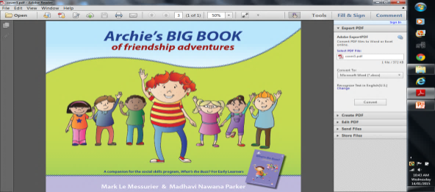
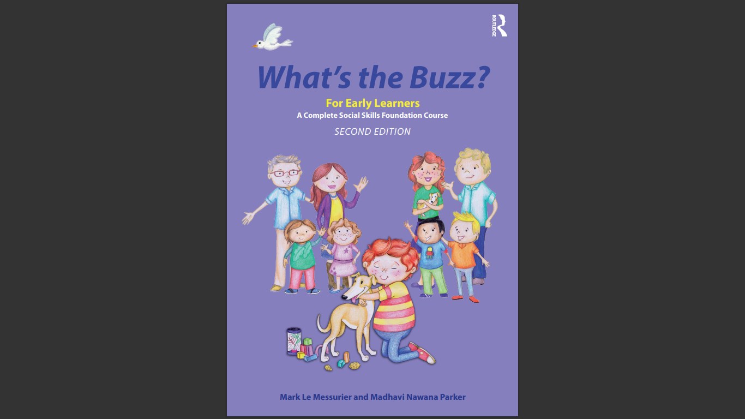
CONTENTS; The EARLY LEARNERS program
First half
• Meeting friends
• Joining in
• Sharing and taking turns
• Cooperation
• Waiting
• Making it better
• Winning and losing
• Fact or opinion
Celebration/ achievement certificates
Second half
• Working with feelings
• Angry feelings
• Building healthy bodies/happy minds
• Honesty
• Saying, “No” (being assertive)
• Empathy
• Worry
• Time to say goodbye
Celebration/ achievement certificates
Notes:
MARK
Here’s the contents from the SECOND EDITION.
This is my moment to say never be a slave to the program.
Take what you want from it.
Feel free to break each lesson up into mini-lessons, if this best suits your student’s needs.
I go to St Patrick’s Special School …

Slide 6
‘What’s the Buzz?’ for PRIMARY STUDENTS
16 lessons
Each lesson can be taught in its entirety, or in smaller convenient parts
‘What’s the Buzz?’ for PRIMARY students (2019) ages 9 to12 years
Notes:
MARK
Next is the PRIMARY program.
This too is a SECOND EDITION.
Note the ages recommended on screen?
These are the publisher’s recommendations – not ours.
Many 14- and 15-year-olds will thrive on this program

Slide 7



CONTENTS: PRIMARY ‘Revised’ program
First half
Meeting people and exiting
Seeking attention
Peer pressure
Being Friendly
Competition
Feelings; yours and everyone’s
Feelings and the warning signs
Feelings and thinking positively
Celebration/
achievement certificates
Second half
Feelings and Wellbeing
Empathy
Anxiety - name it!
Handling Disappointment
Bullying
The ART of conversation
Self-awareness: EQ
The value of feedback
Celebration/
achievement certificates
Notes:
MARK
Here’s the contents.
Each lesson comes with a short Archie Story at the beginning to set the scene.
Also note the insertion of’ 4 new chapters.

Slide 8

‘What’s the Buzz?’ with TEENAGERS?
16 lessons
Each lesson can be taught in its entirety, or in smaller convenient parts
‘What’s the Buzz? with Teenagers (2019)
Recommended for students aged 12 to15 years
Notes:
MARK
Lastly, here’s ‘What’s the Buzz with Teens?’
Archie has grown up.
He now experiences the same social and emotional issues that match the complexity of this age group.
This new edition comes with a short Archie Story at the beginning of each lesson to set the scene.
Generally speaking, Year 7’s, 8’s and 9’s will benefit from the concepts within the program

Slide 9

Contents
Lesson 1: the ins and outs of friendships
Lesson 2: what is a friend?
Lesson 3: switching on positivity
Lesson 4: wellbeing and social media
Lesson 5: empathy
Lesson 6: resilience
Lesson 7: dealing with disappointment (loss and grief)
Lesson 8: handling anxiety
Lesson 9: responding to dominating behaviours
Lesson 10: being hurt, trolled or abused online
Lesson 11: relationships; feedback and compliments
Lesson 12: effective listening
Lesson 13: Competition, winning and losing
Lesson 14: charity; acts of kindness
Lesson 15: perseverance
Lesson 16: Self-identity
Notes:
MARK
The book has 10 chapters, and the other 6 can be accessed online from our WTB website.
As you’d expect, several lessons focus on social media, how to use it, how to keep a balance in life and what to do if things aren't going so well online.
Chapters touch on the reoccurring themes of;
- friendships
- empathy
- resilience
- dealing with disappointment (loss and grief)
- handling anxiety
- responding to dominating behaviours
- competition, winning and losing
- and, perseverance

Slide 10

Lesson 9: Responding to dominating behaviours
The learning intention - Materials required - Explanation
1. What’s the Buzz?
Archie’s story; “Put your hand up if you don’t want Rafi to be in our group?”
2. Show me the Buzz
Choose from PART ONE or PART TWO
PART ONE
1. ‘Where did Rafi go wrong?’ - rewrite, retell or perform a play
2. Group discussion – ‘real life’
3. Group discussion – ‘social media’
4. Watch this film clip and discuss
5. Sledging and trash-talk
6. Quiz: Do you show bullying patterns of behaviour?
7. HELPFUL and UNHELPFUL possibilities
PART TWO
The role-play - ‘Responding to dominating behaviours’
3. Do you know the Buzz?
4. The Buzz
5. After the Buzz, social thinking ideas for parents and caregivers
Notes:
MARK
This screen is an overview of lesson 9.
I’d like to walk you through it …
At the top of the screen there’s - The learning intention - Materials required – Explanation
Then, there’s ‘What’s the Buzz?’ It’s an ‘Archie’s story’. These are short, and set the scene.
Next, we move to ‘Show me the Buzz’ Show me the Buzz – an opportunity to discuss a variety of ideas, absorb the thoughts of others, debate them, or create role-plays.
There’s always a PART ONE and PART TWO.
So, choose one activity from either PART ONE or from PART TWO, depending on what appeals to you, and your group’s likely preferences.
Part 3 is 3. Do you know the Buzz?
This generates a lively group ‘discussion’ where students briefly respond to a series of questions and statements highlighted by Archie’s story.
Part 4 is ‘The Buzz’ - an opportunity for the group to play games that strengthen their friendship and the skills central to this lesson.
And, finally - After the Buzz, social thinking ideas for parents and caregivers
This section contains ideas for parents, guardians and educators to encourage the social and emotional thinking students have touched on during the lesson.

Slide 11

Our 5 neuroaffirming groupwork principles
Notes:
Noni
Every educator is expected to understand and promote neuroaffirming principles.
We have different “Neurotypes” in our groups.
This means we have people with different “types” of brains - not to be fixed, but one way to exist within the complete diversity of human brains.
As you know, some neurotypes develop very early in life (such as ADHD, Autism or learning difficulties).
Others develop later, through experiences such as PTSD and trauma.

Slide 12


1 of 5 neuroaffirming principles
Notes:
NONI
The first neuroaffirming principle is to embrace change; be open to new ideas, new learning and adapt.
Neuroaffirming understandings are changing at light speed in the community.
There’s a revolution in the way we think about, discuss, and respond to people under the neurodivergent umbrella.
And now there is a big responsibility for us to impart this to the kids we work alongside.

Slide 13
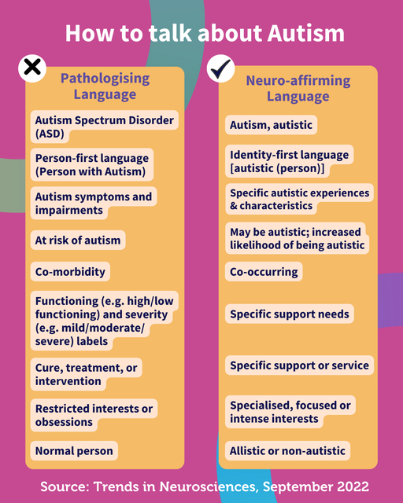
Notes:
NONI
The second is the language we use.
As dad mentioned, we avoid language that views another as less or inferior, or in need of fixing, or changing.
We use language that values neurodiversity and sees it as part of a person's identity.
As a reminder, we now –
use the words Autism or Autistic, rather than ASD
we remove barriers instead of labelling human beings with high and low functioning labels
we openly talk about accommodations and supports, rather than interventions aimed at changing core Autistic traits
we respect and talk about the concept of masking because when an Autistic masks, it’s unfair, calls for a huge effort and causes anxiety, burnout, depression or the loss of one’s authentic self.

Slide 14

3 of 5 neuroaffirming principles
Notes:
NONI
The third principle is hearing more from those with a ‘Lived Experience’.
We gain so much more when we slow down, share, listen, and appreciate how others experience and process the world.
We now know neurodivergents do best when they are supported to set their own goals.
So, we should be asking them, "What helps you to feel valued, understood and supported?"

Slide 15
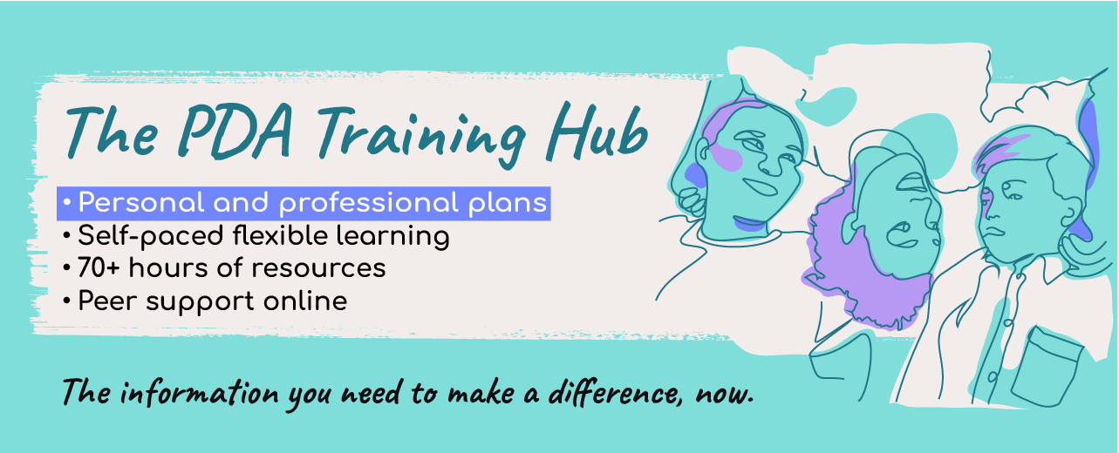
Excellent websites offering gold-standard understandings on working with PDA
www.pdasociety.org.uk
www.pdasociety.org.uk/what-helps-guides
www.kristyforbes.com.au/pda
www.stephstwogirls.co.uk/2022/01/how-to-help-children-with-pathological.html
www.prosperhealth.io/blog/how-to-manage-pda
Notes:
NONI
The 4th neuroaffirming principle is recognising PDA, sharing it with Autistics and learning how to work with it.
Emerging research suggests 50% of Neurodivergents (Autism and ADHD included) have PDA markers.
In the general population, the prevalence is less than 1%.
PDA is a profile of behaviour, usually within Autism.
PDA stands for Pathological Demand Avoidance.
That’s not neuroaffirming, so many of us call it - ‘Persistent Drive for Autonomy’.
It’s accurate and so much kinder.
PDA behaviours are anxiety-based.
So, this person will react strongly to the DEMAND being PUT on them!
Suddenly, they may get angry at you.
They must control the situation.
And their anger often presses buttons in adults.
This is why we encourage children and young people in BUZZ to say “NO” or “PASS” if they don’t want to do something.
Instead, they’re comfortable, watch, listen and learn.
It is driven by the UNCERTAINTY that the DEMAND brings.
It’s all about AVOIDING that DEMAND.
It can now, formally, be identified.

Slide 16
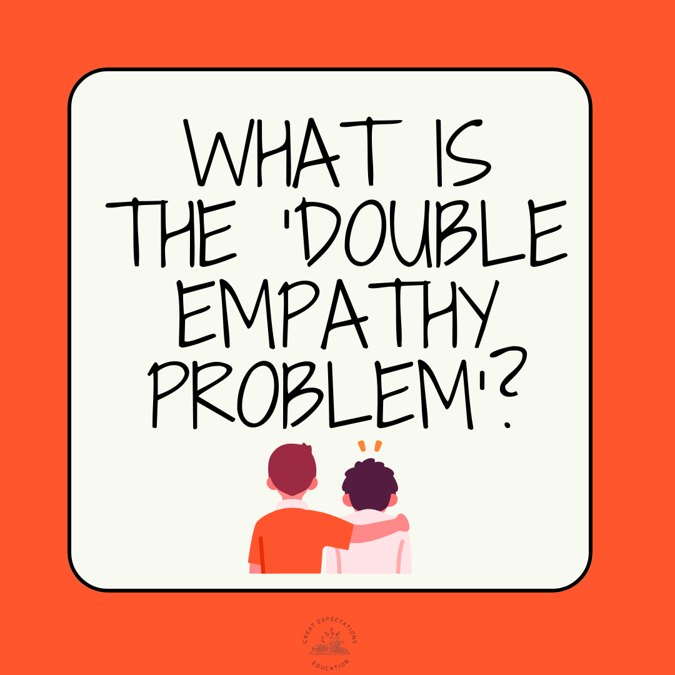
5 of 5 neuroaffirming principles
Notes:
Finally, to the ‘double empathy problem.’
It was raised by Damian Milton in 2012.
He challenged the traditional view.
The traditional view was that the Autistics were the problem because they have the problem.

Slide 17
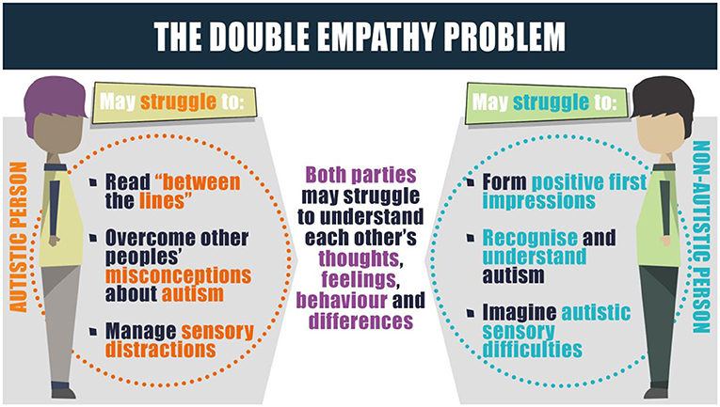
Notes:
Milton said, every solution is a shared responsibility.
Each of us must bridge differences.
The onus should NOT be on Autistics to adapt or mask.
The double empathy lens shows that the strategies we build for Autistics, frequently turn out to advantage everyone.
Here are 4 quick examples.
1. Think about the quiet rooms that now exist at the Adelaide Royal Show and in AFL and Basketball stadiums. Many people now use them – not just Autistics.
2. The mobile bus that travels to all kinds of events in Adelaide, originally designed as a quiet retreat for Autistics, has now become a quiet retreat for many others.
3. Although first set up for Autistics and the disabled, Australian airports run the ‘Sunflower Program,’ offering special supports to help everyone.
4. And, supermarkets are addressing the Double Empathy problem with new sensory-friendly shopping hours.
The stores dim lights, turn music off, avoid announcements, reduce trolley movement, and turn checkout beeps off.
A much better way for all of us to shop!

Slide 18

Touch Blue
Notes:
MARK
Thanks for your listening to our neuroaffirming principles.
I’m sure we’re in synch.
Now, let’s recharge you!
This game is called - "Touch Blue“
The idea is for you to move quickly to touch something that matches my instruction.
Touch a table …. Your’re quck! You get it!
Touch wood
Touch material
Touch glass
Touch high up
Touch low down
Touch a brick
Touch a metal surface
Touch a book
Touch another person
Touch brown
Touch a chair
Touch a screen
Touch a blind
Touch timber
Touch a lovely person ….

Slide 19
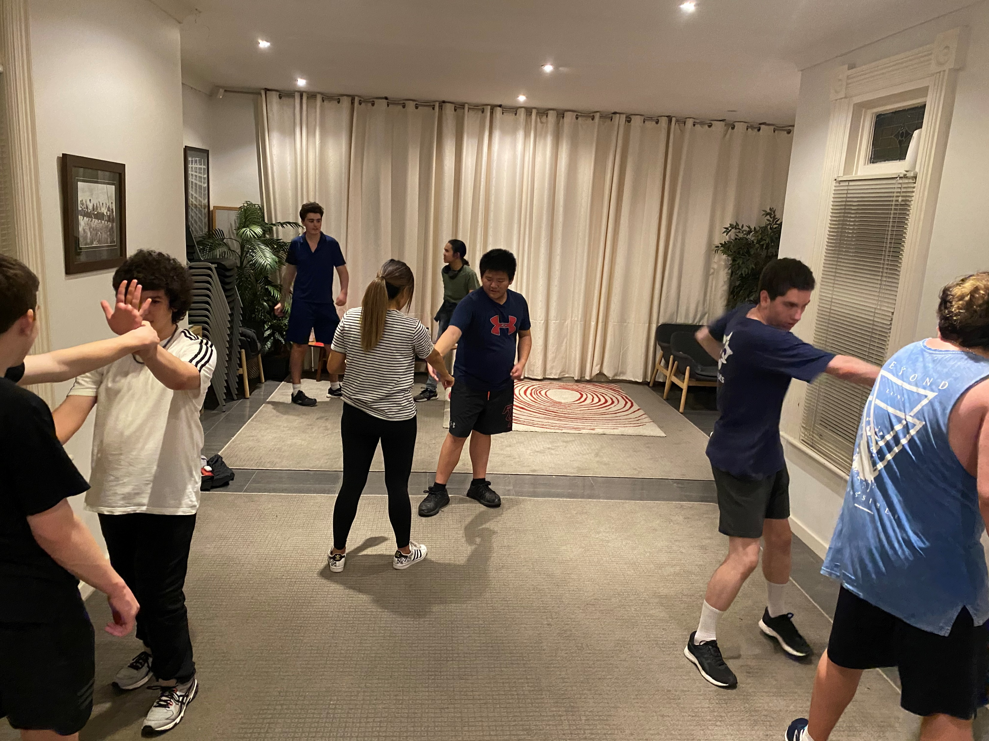

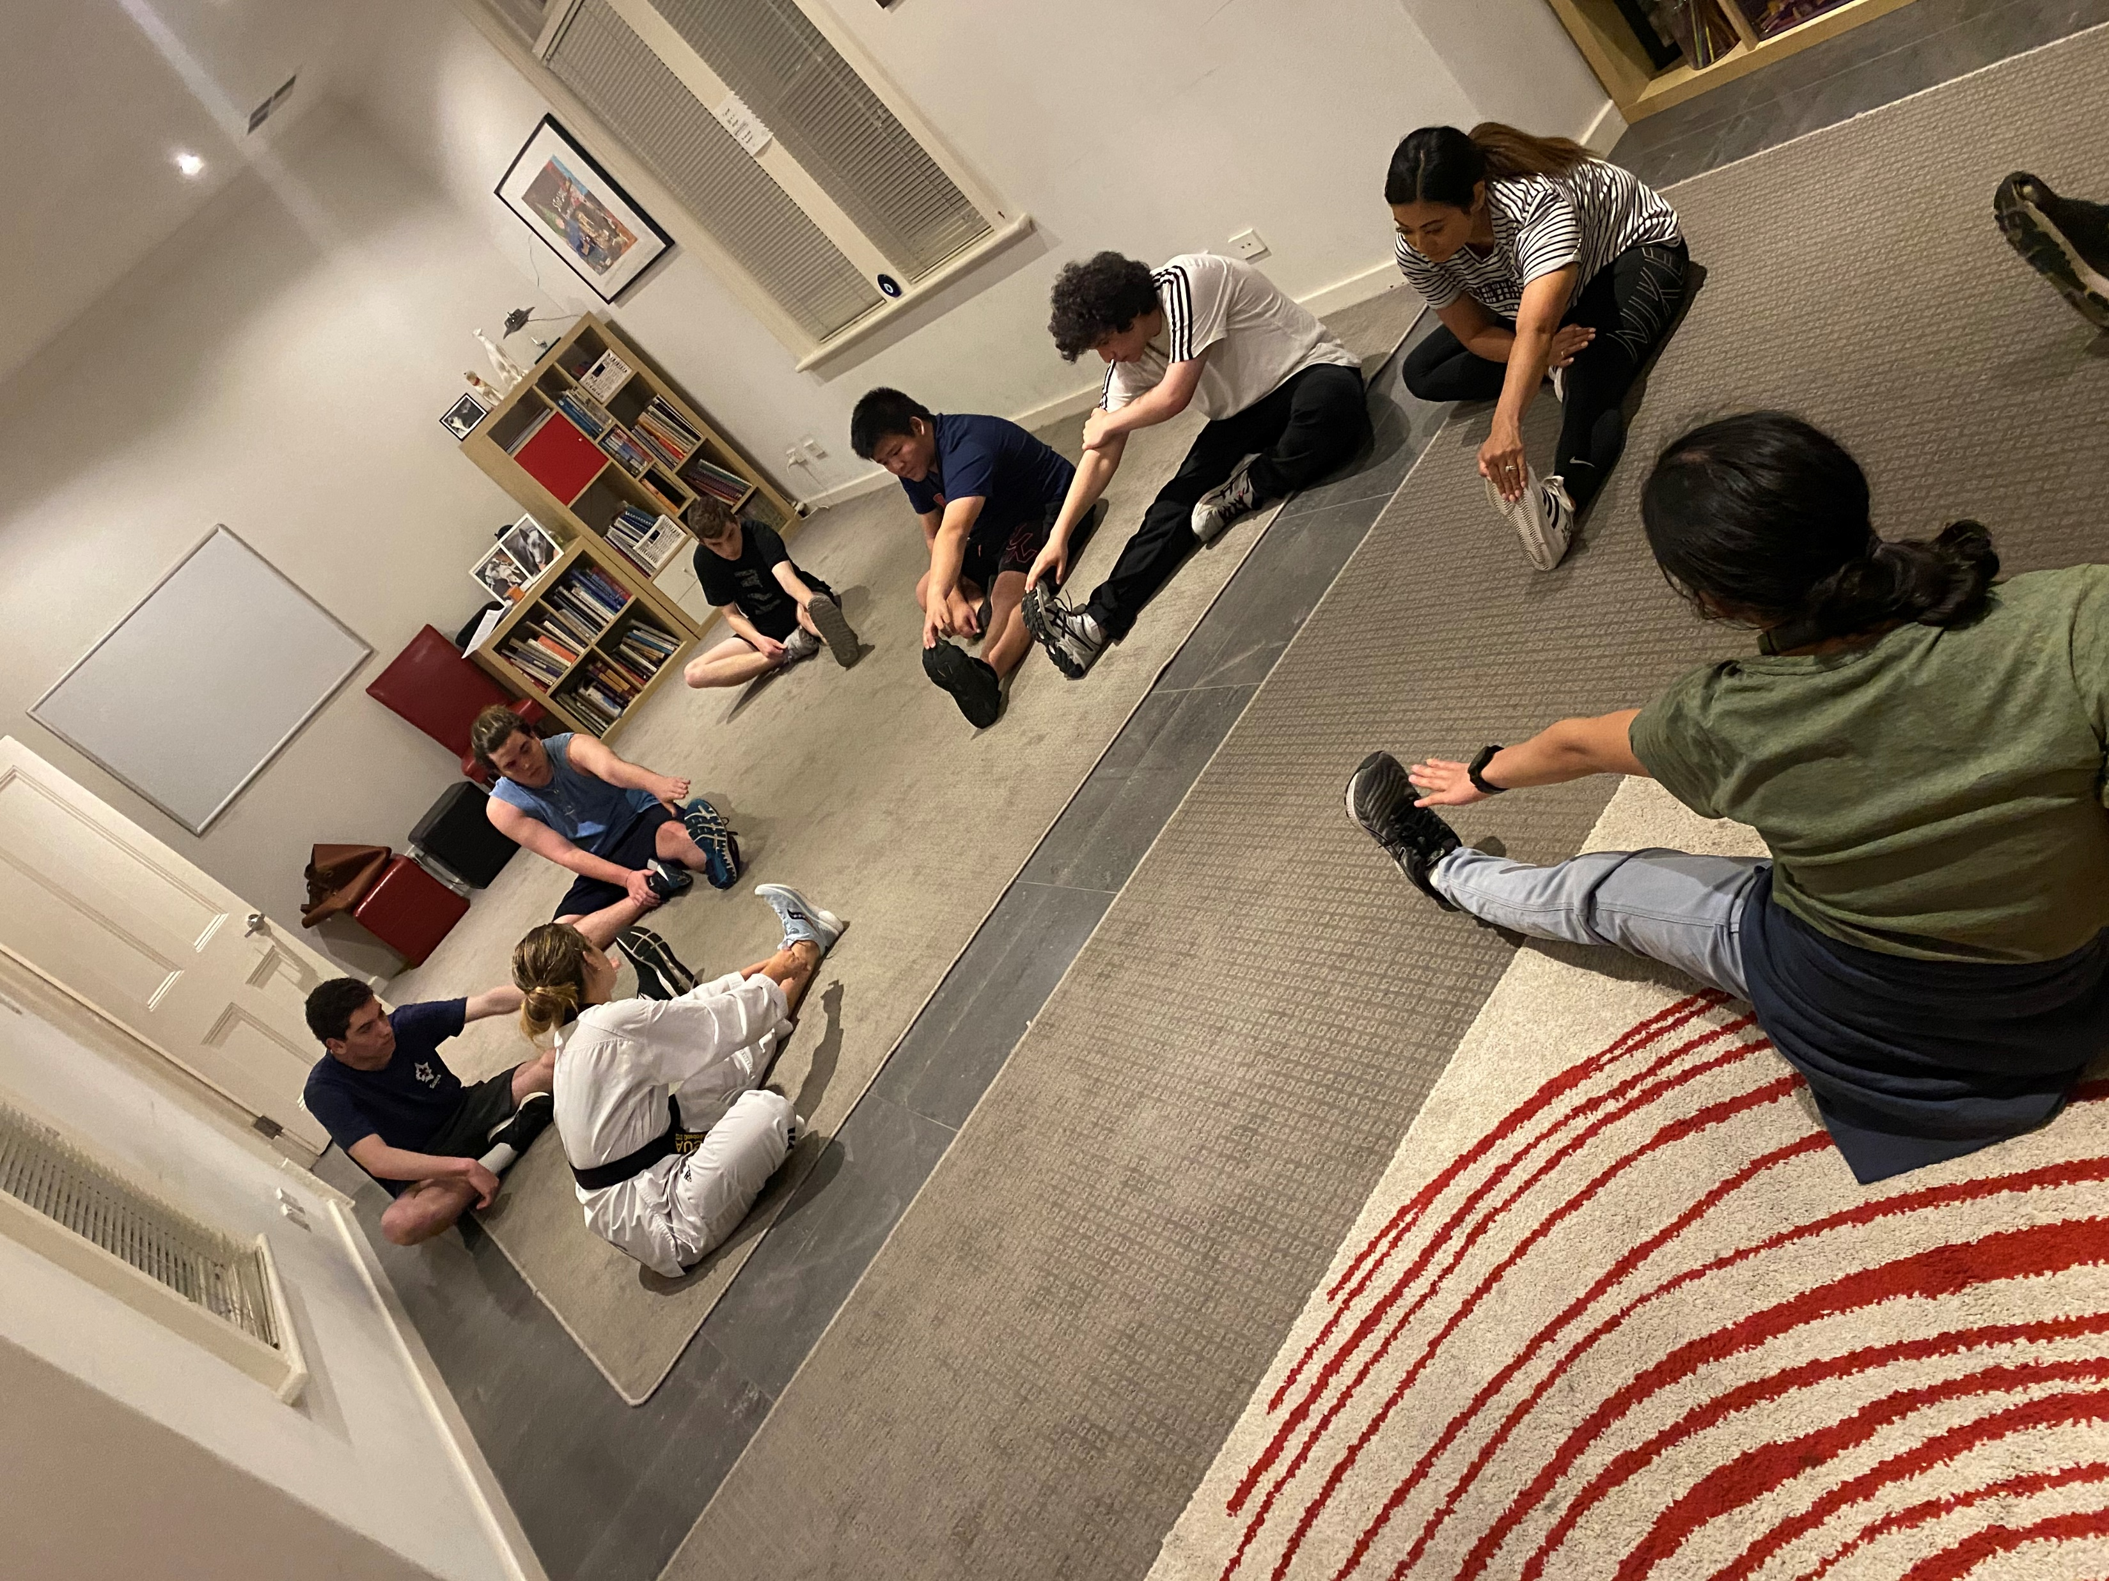
Notes:
NONI
(keep an eye on the time … want this section to wind up just after 12 so we have an hour for our lesson)
So, between dad and myself and several co-facilitators we run 13 groups of 10 kids, teens and adults, each week.
That’s 160 young people we see in groups every week, besides our private 1:1 work with kids and families.
And in the January holidays we do a separate 8 groups over 3 weeks.
We start children in the EARLY LEARNERS program at 6 years.
Many do WTB 5, 6 and 7 times over.
Say something about these images on screen …
Every so often we’ll organise guest facilitator to come along.
Here’s Amelia doing self defence with a group.
These provide a good change up to the session especially if you’ve had the same group together for a while.
Our oldest groups are in their mid-20’s now, and they have taught us something worth sharing.
Initially, we held a view that we taught kids NEW SKILLS and then let them fly.
What we’ve learnt is that this works for some but not for others.

Slide 20
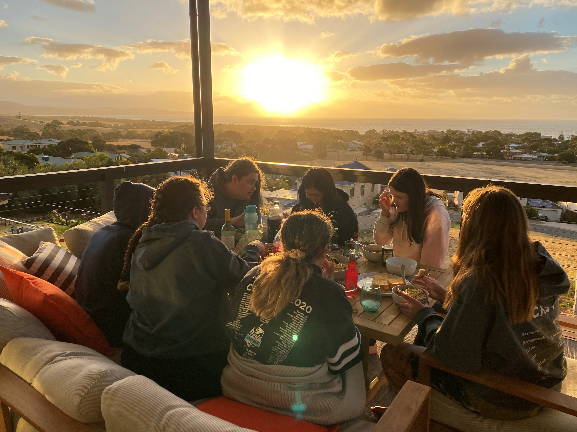
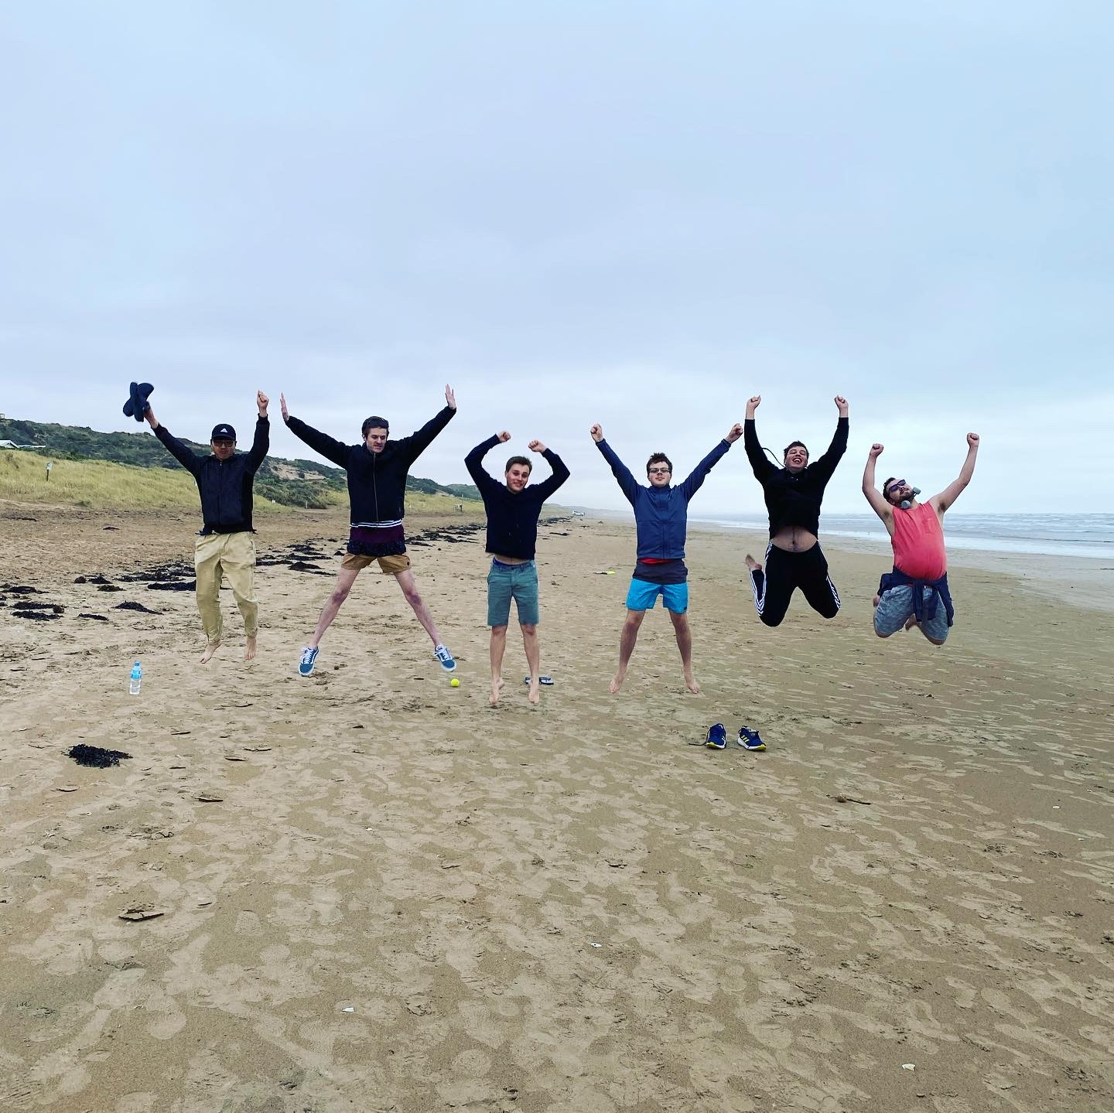
Notes:
NONI
There’s a large group of teens and adults, especially those neurodivergent thinkers, that rely on the continuity of weekly, structured meetings.
Without the opportunity to come along each week, to connect with others, to laugh and exchange they would not be connecting.
They’ll tell you, that they’d would be at home, probably in their bedrooms, and most certainly feeling lonely, sad or depressed.
Our program and its structure is the motivation for them to touch base with friends, face to face, and to make plans to meet through the week that otherwise would never be made.
They grow together, share new experiences and milestones within their Buzz group.
Say something about these images on screen …

Slide 21
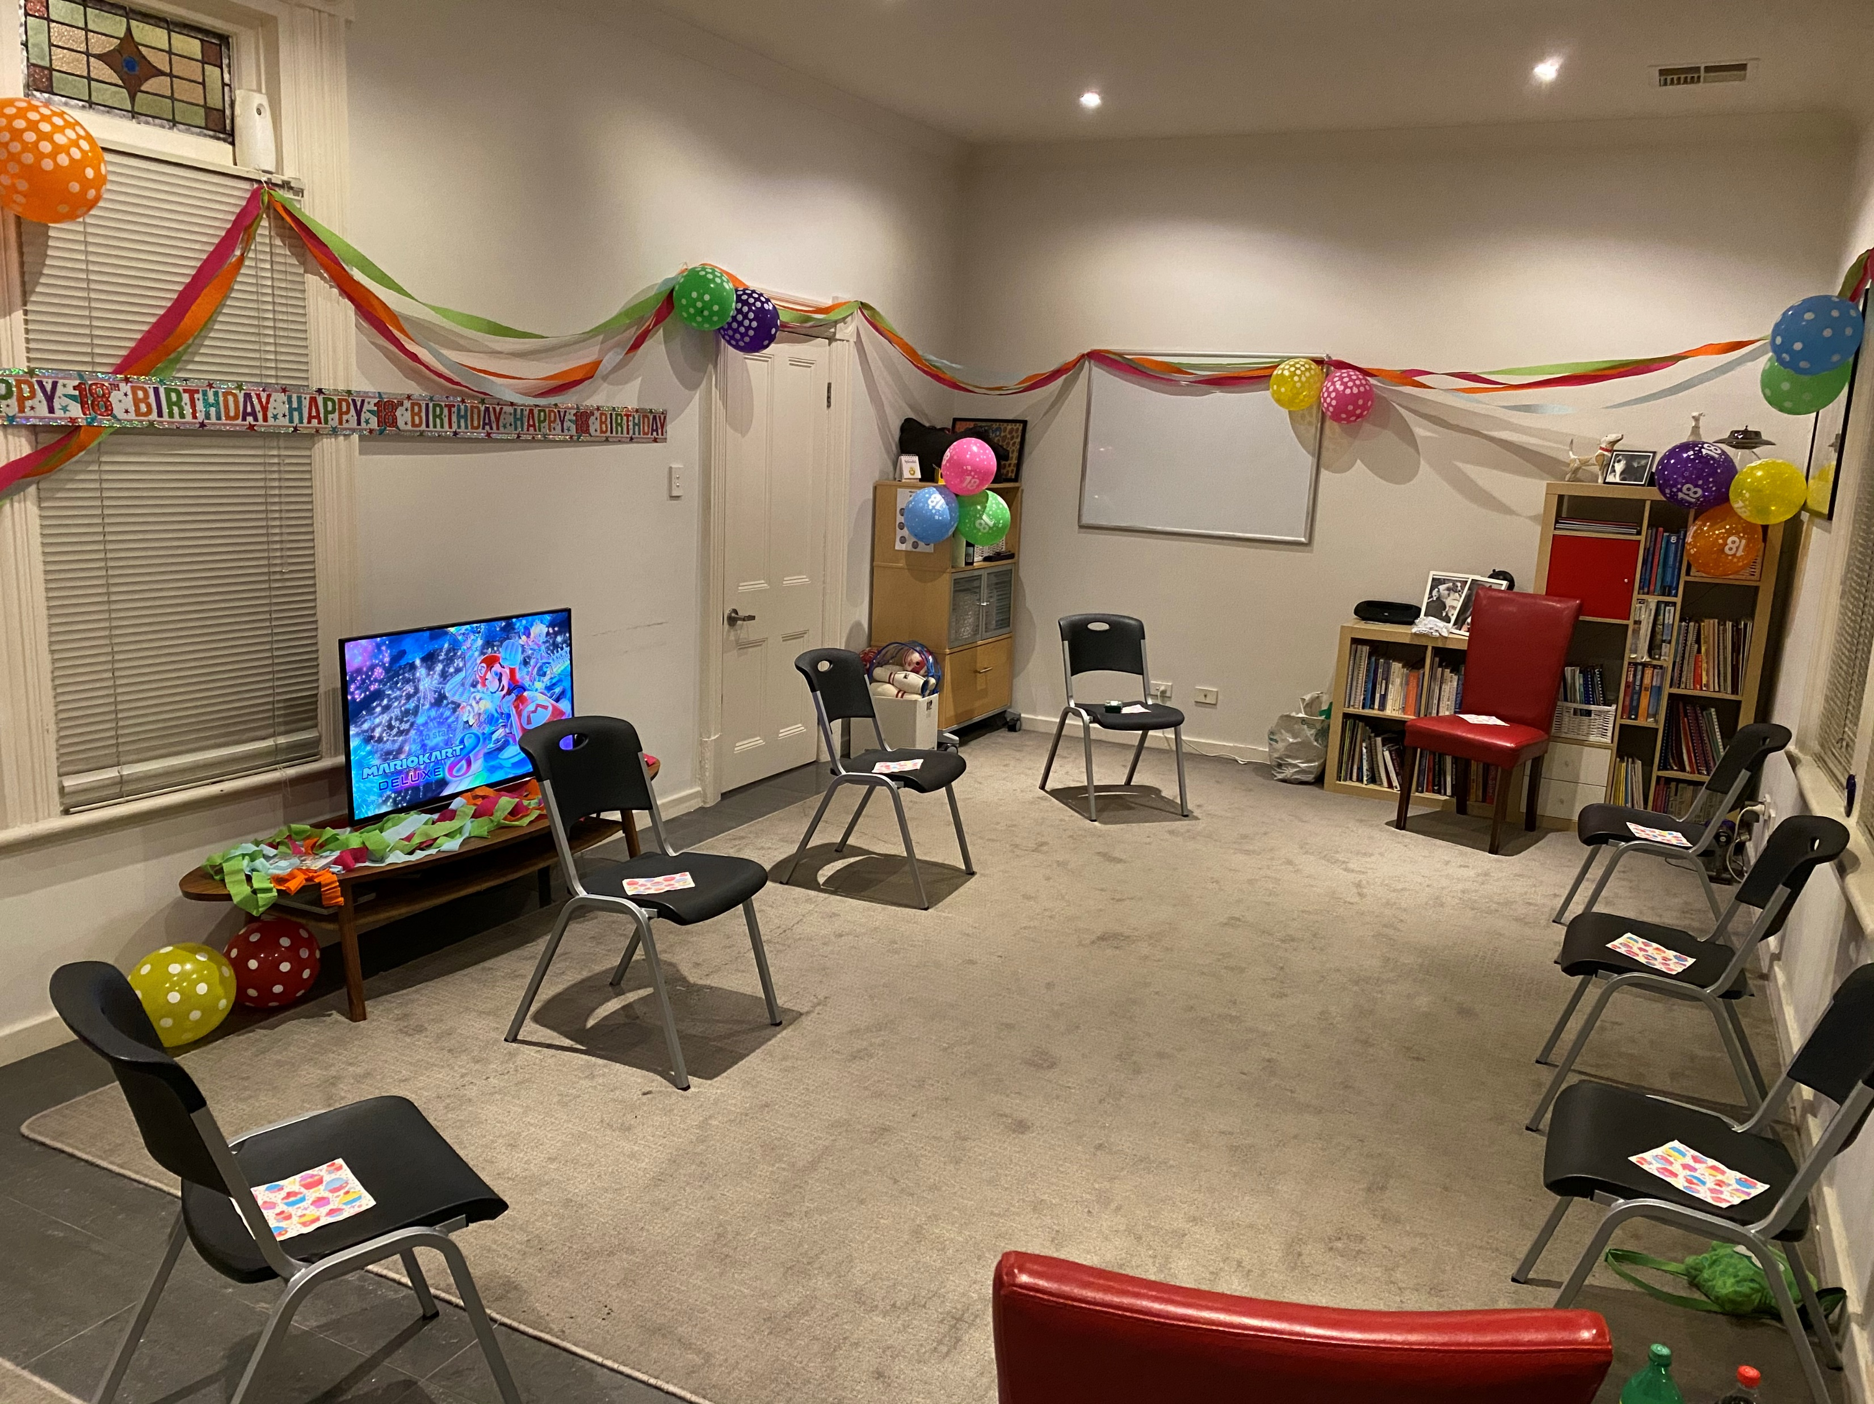
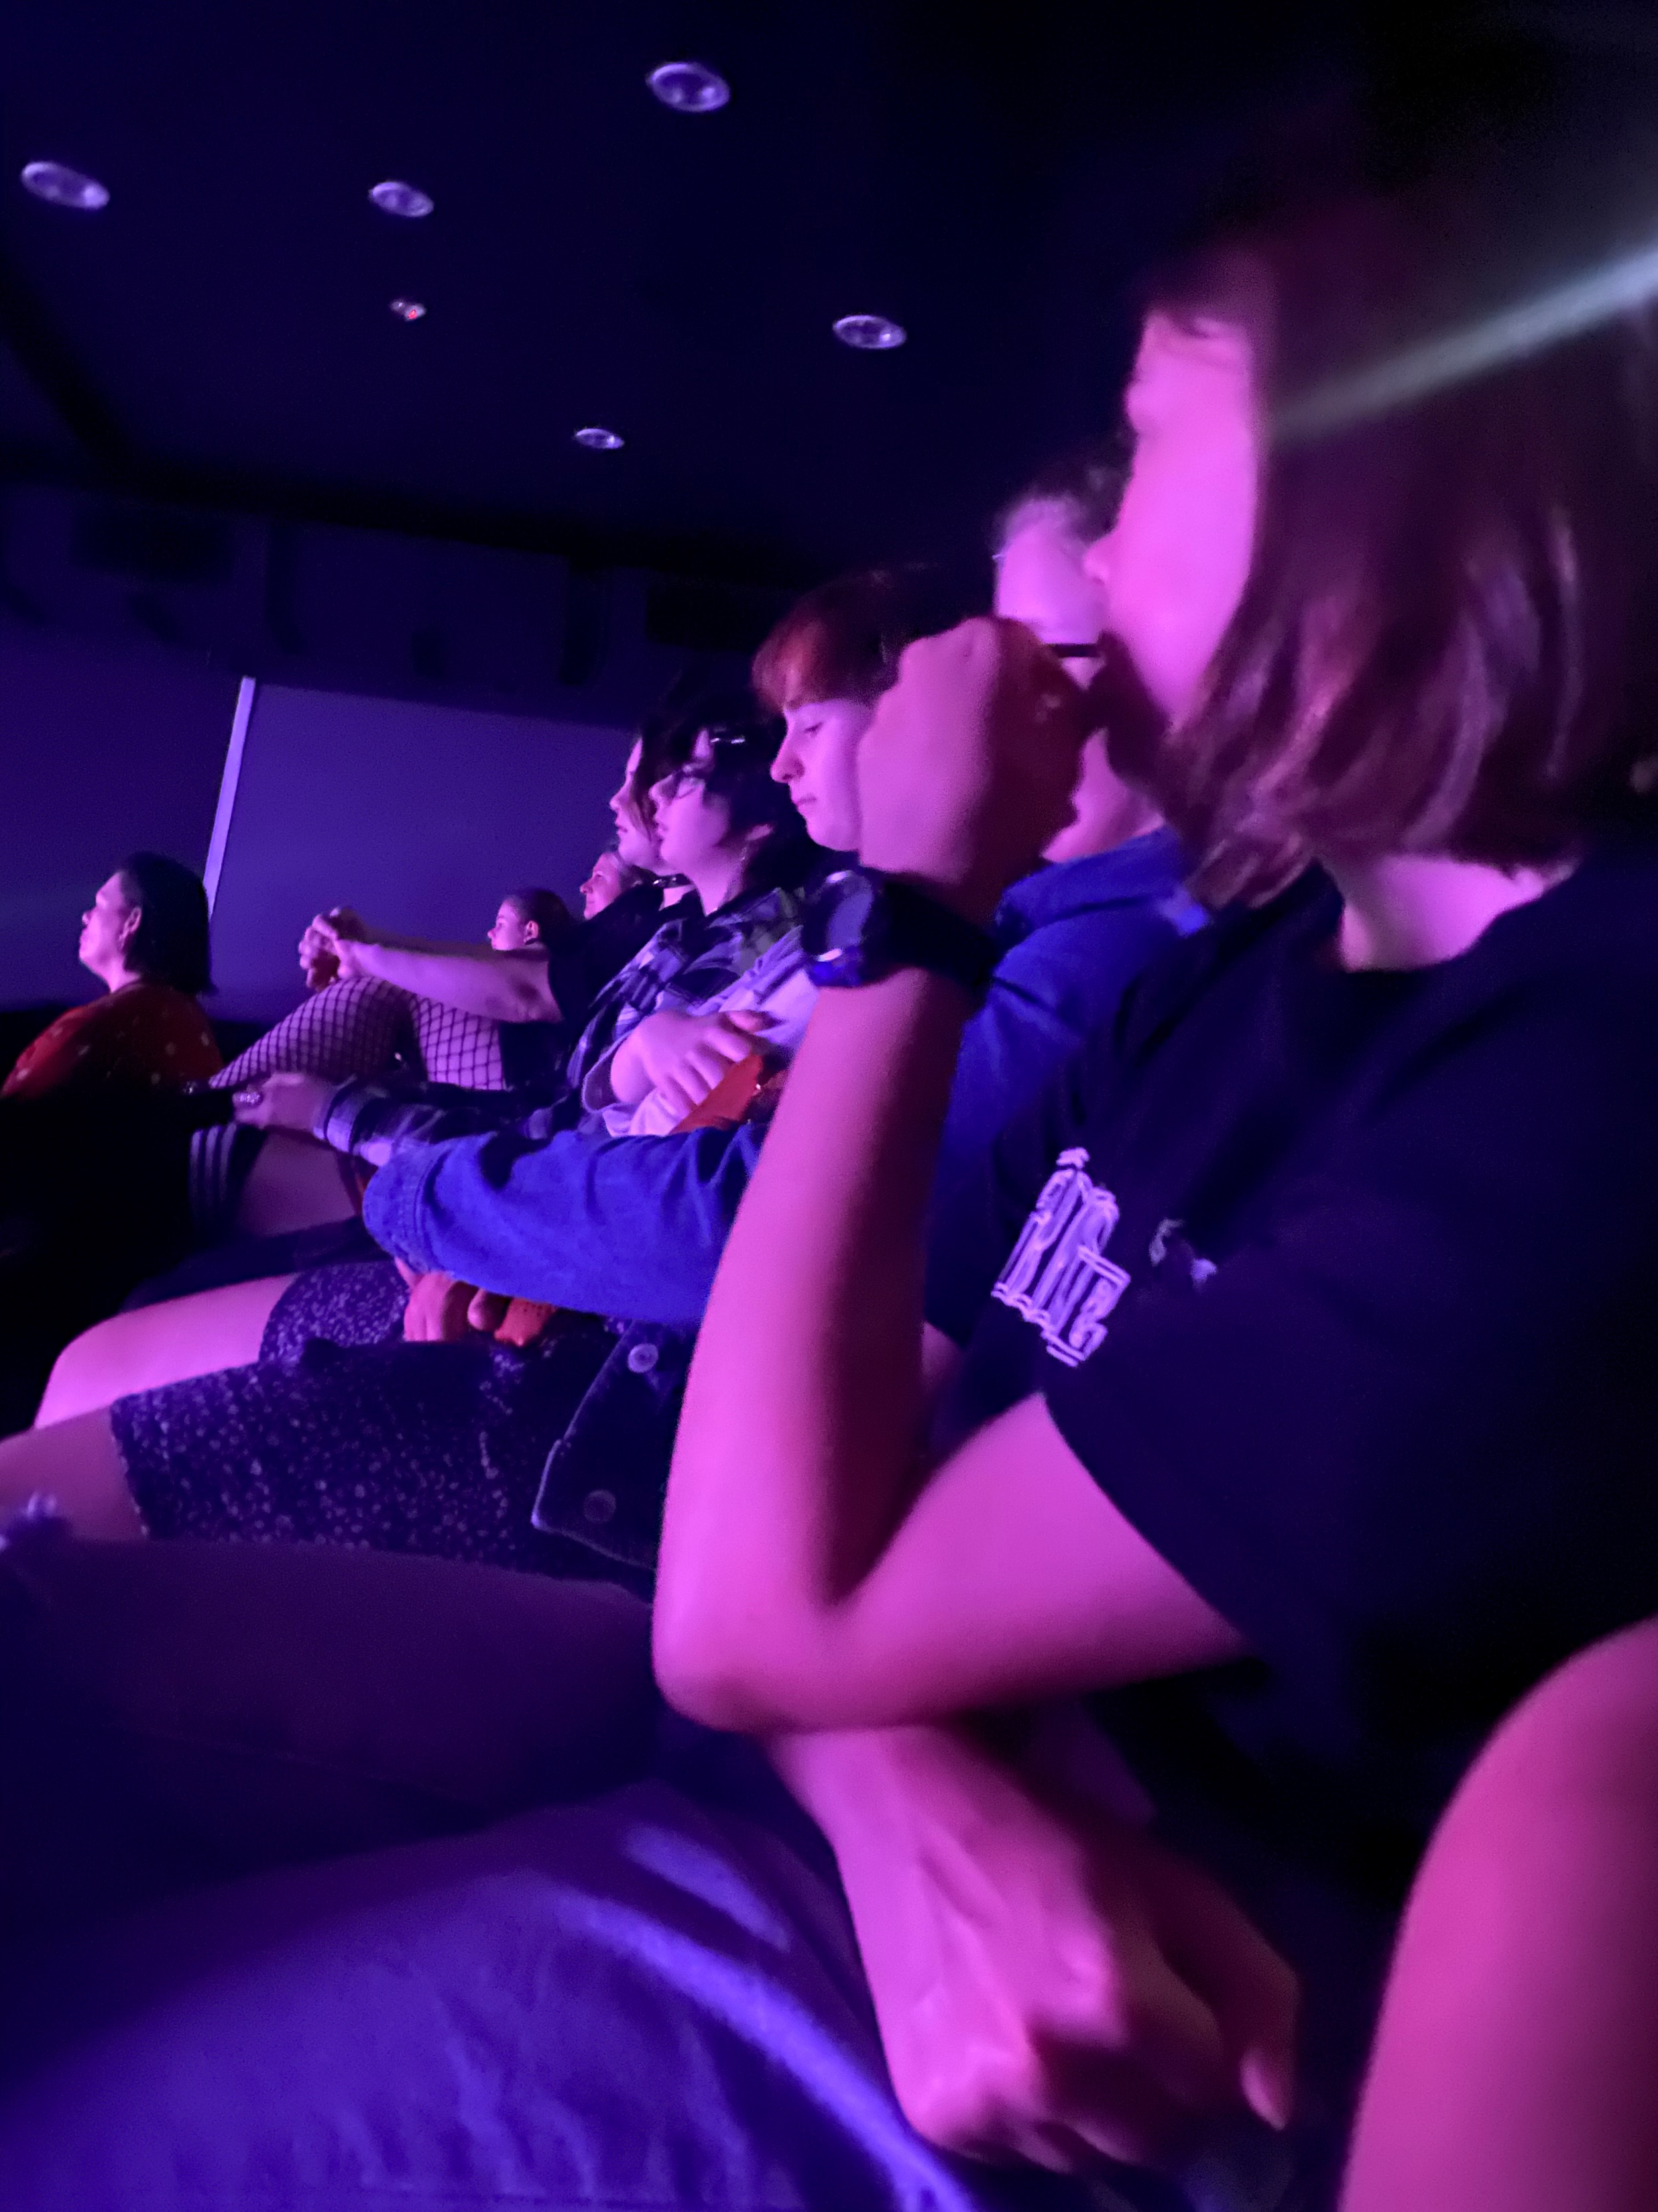
Notes:
NONI
There are some special things to take into consideration when running teen and young adult groups…
Work hard to make them feel comfortable - win them over fast!
Once achieved, they’ll want to return the next week.
If they leave unsure, then the anxiety of returning builds and it is harder to capture their interest in the following weeks.
So, be relaxed and warm and help them to connect with each other.
Joke and banter with your co-facilitator – it helps to ease everyone’s anxiety – especially early on.
When you create a relaxed and positive feel quickly, teens will want to be there.
It’s almost a guaranteed recipe for success!
Laughter helps them realise it’s fun, connecting, and that we can create exactly what we want!
Say something about these images on screen …

Slide 22
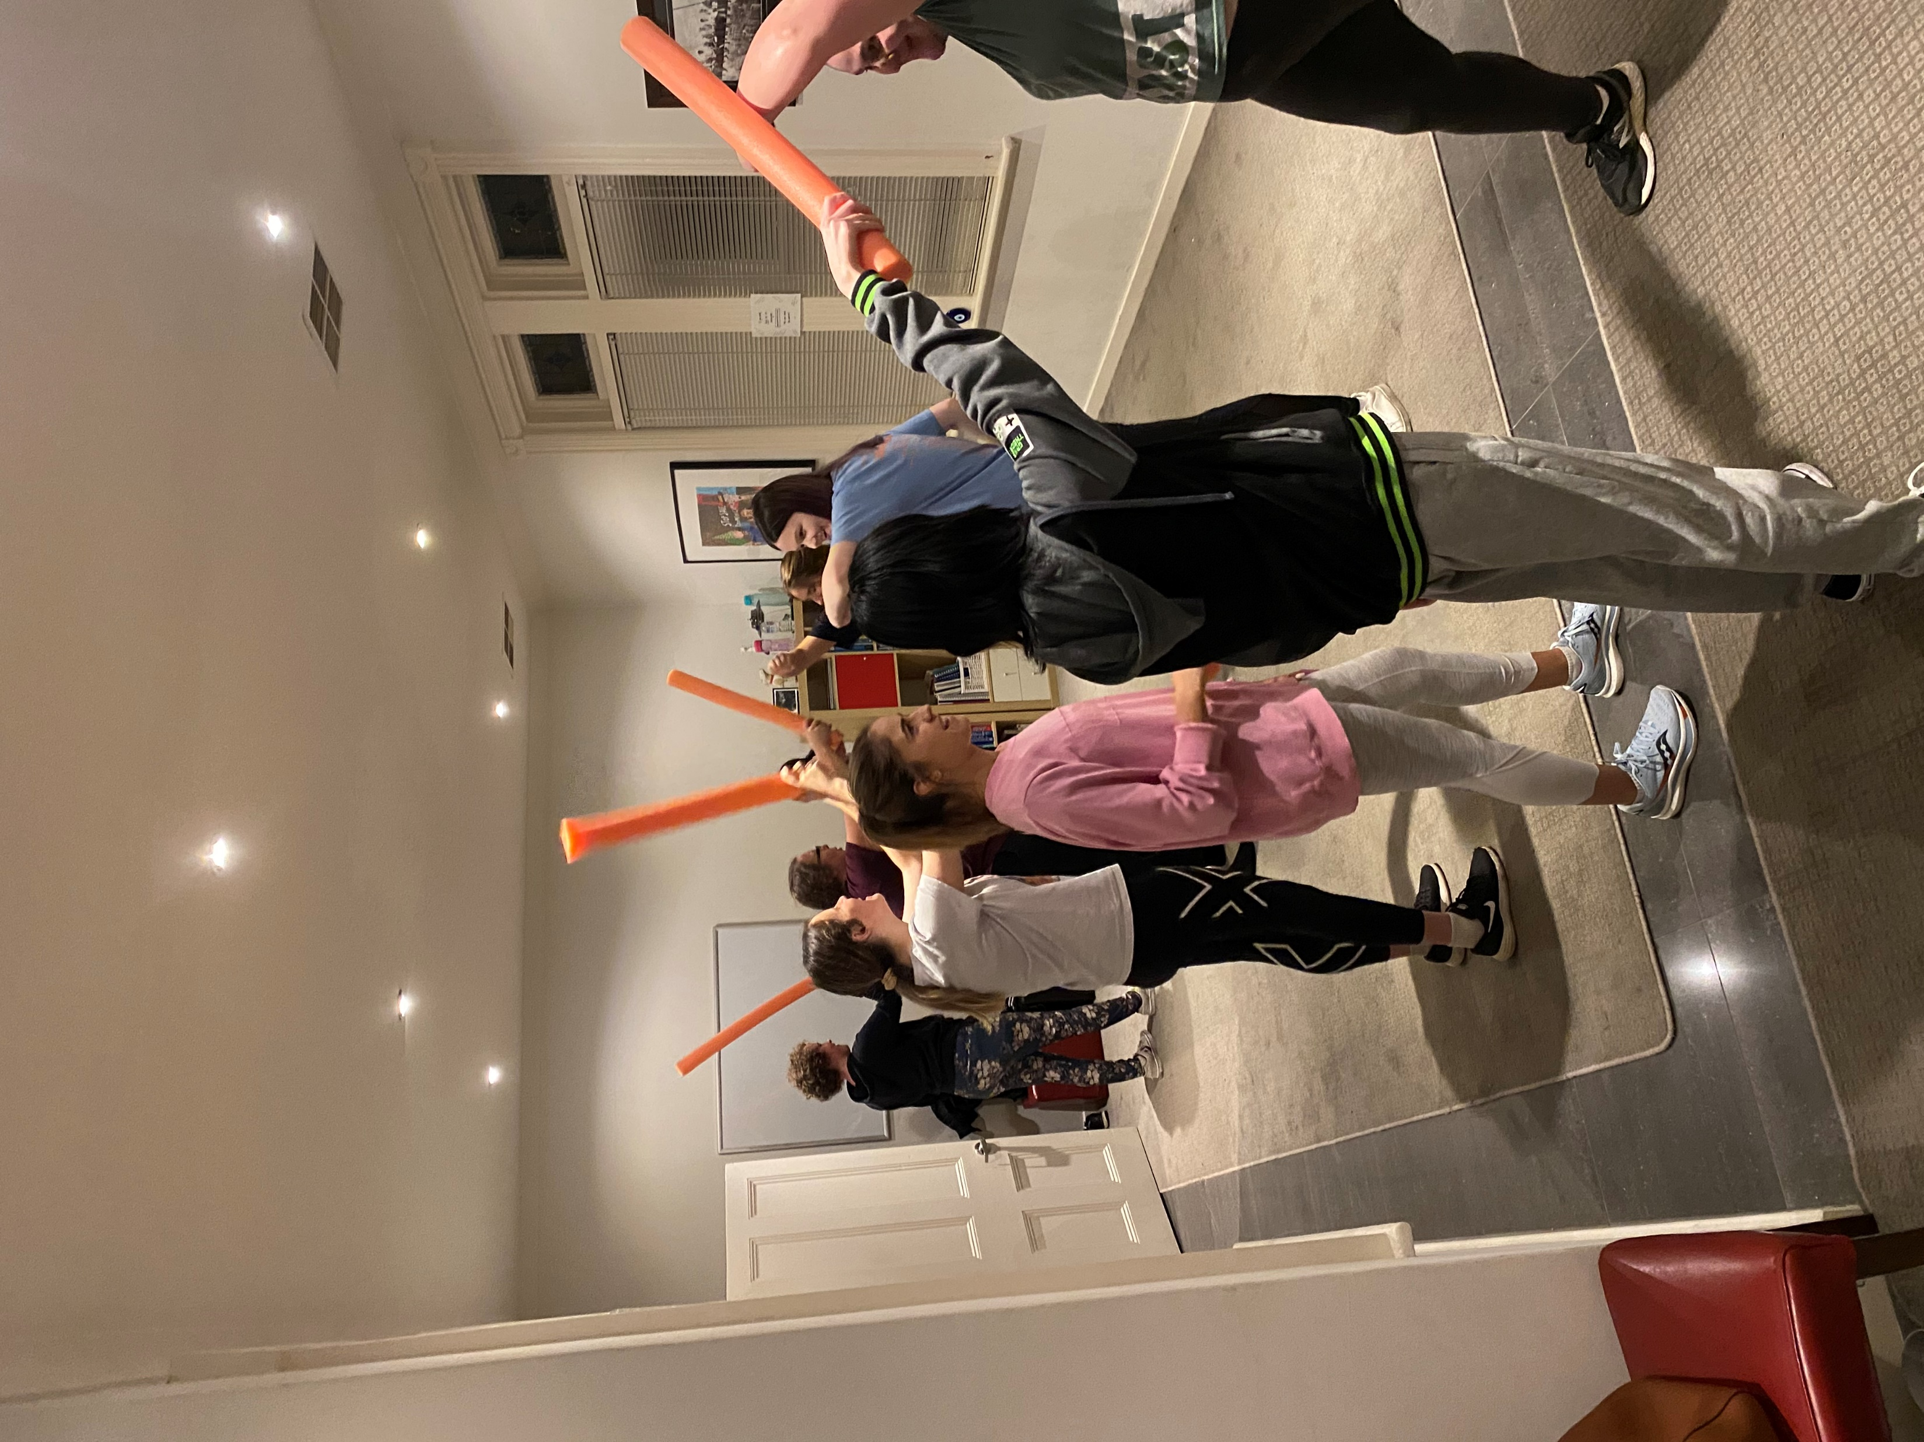
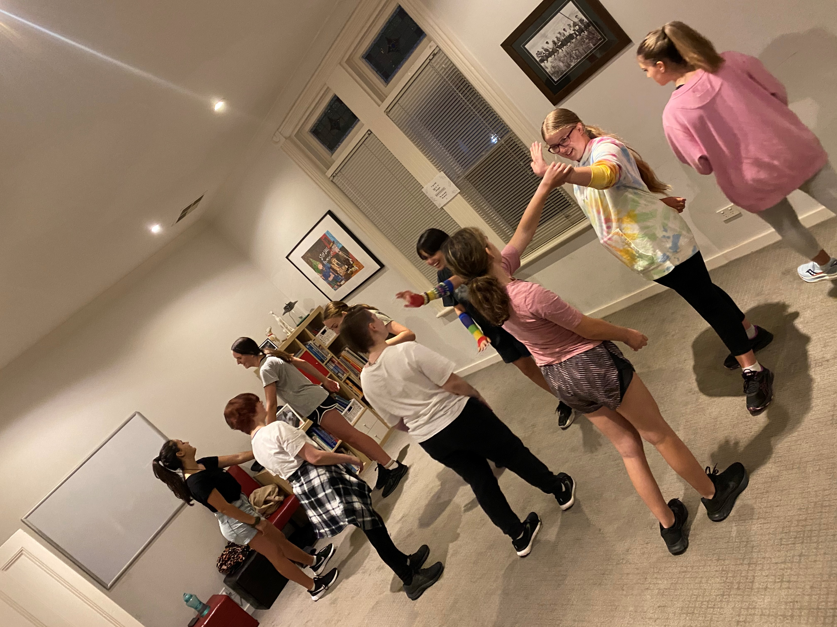
Notes:
NONI
Teens, especially, want to get to know you personally.
Let them into your life so they get a glimpse of your LIVED EXPERIENCE.
So, share stories, that let them see your imperfections.
This helps them to see that life, for each of us, is a messy work in progress – there are always steps forwards and steps back.
They’re not meant to be accomplished.
It takes a long time to be accomplished at anything or to truly feel confident.
When they feel like you’re truly WITH them, they’ll feel more at ease, and more attached.
Continuously highlight that while we’re all different, most of us share similar worries, like …
Friendships
The future
Home and parents
School and teachers
Being too tall, too short, too wide, too skinny
Or feeling different.
Say something about these images on screen …

Slide 23
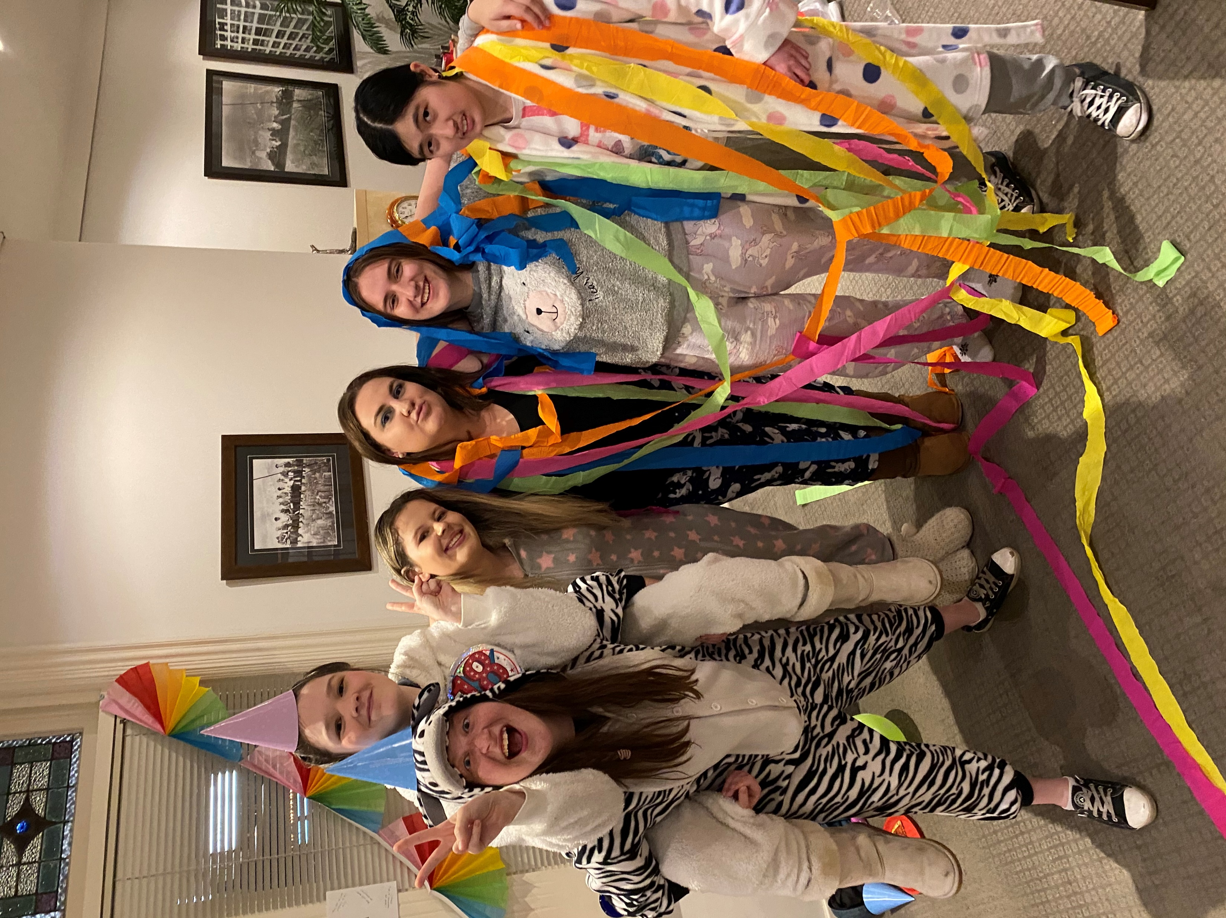
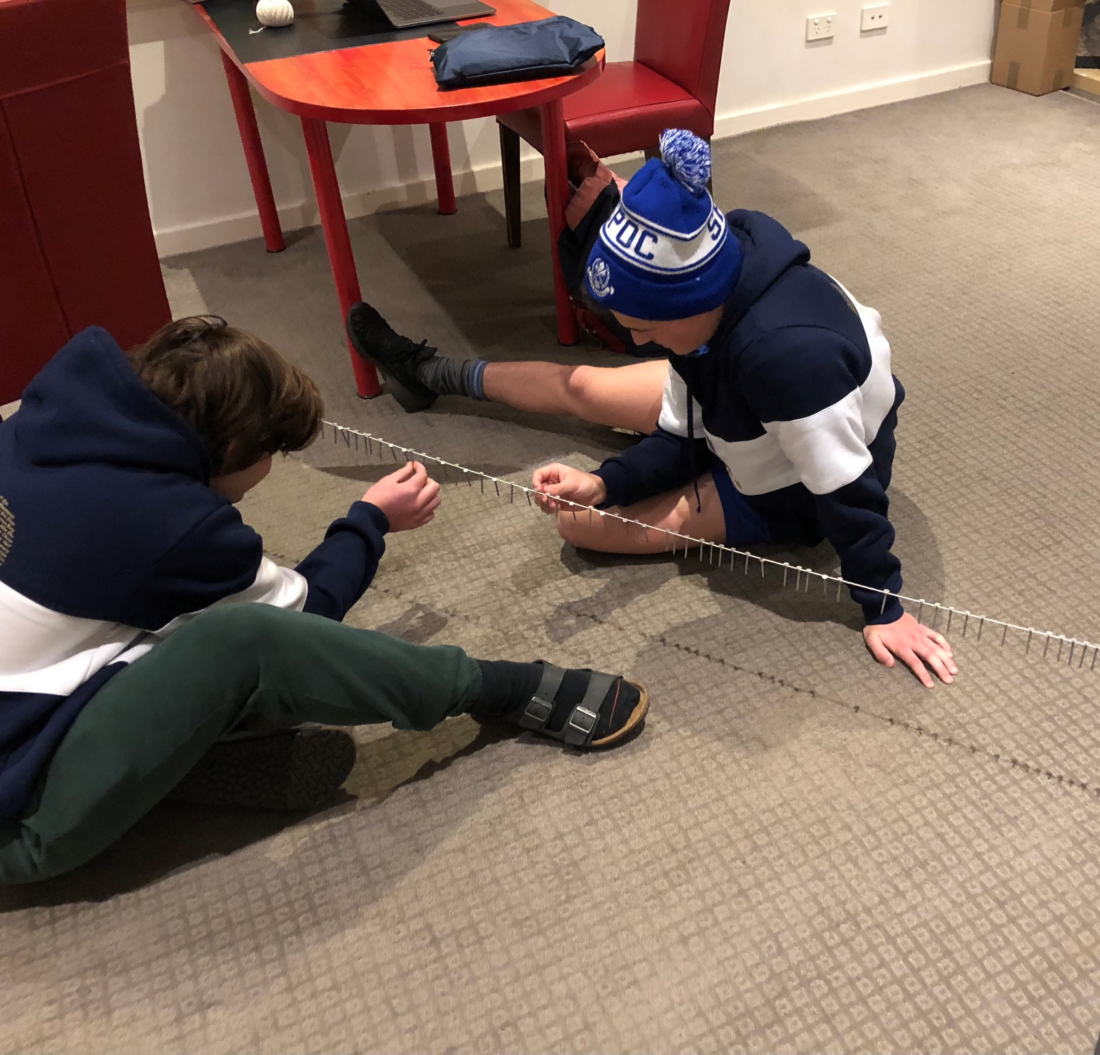
Notes:
NONI
Once teens begin to feel comfortable, you’ll be amazed by the warmth and honesty in their sharing.
Many just want to compare their thoughts and feelings with others.
They’ll say, “Just want to check if this is normal!’
A few week ago, someone asked, “Hey? Has anyone else here got Autism?”
Plenty of hands went up and a positively encouraging discussion about Autism followed, and by the way, where else do you get such quality conversations?
The next moment another called out, “So does that make you a single A battery?
“What do you mean?”
“Well, Autism starts with A. I have Autism and ADHD, so I’m an AA battery.”
Within a heartbeat another group member chipped in, saying, “Then, I’m a AAA because I've got Autism, ADHD and Anxiety!”
They connect over so many things … a diagnosis, games, interests, dislike of things, sensory stuff, what therapists have told them, etc.
It makes them feel so good that other people just get it without them having to explain it in detail or start at the beginning.
Say something about these images on screen …

Slide 24
24 of 70 topics
Is there a right way to ‘break up’ with friends?
MONEY: from what you spend your money on to financial literacy
Toxic friendships and people
Dating Apps advice and safety
Organising a trip away
Expectations of friends; what’s okay and what’s not
Dancing, club etiquette and what to wear
Alcohol Education
How to deal with dickheads/aggression/conflict
Gender identity and sexuality
Phone Numbers: and how to get them with style
Personal Hygiene
What helps you become more independent?
Teasing Versus Banter
Relationships – how to meet people, talk to them, and start something
What is romantic attraction?
Safety – going out
Sex/Drugs
Bra Sizes
Online Dating
Timeframes on arriving and leaving events
Relationship rules
Things we judge, or do we?
Is telling a LIE ever okay?
Notes:
NONI – check time – need to finish about 12:10
For our older teen groups we don’t change topics every week.
When it grabs them, we can go 2 or 3 weeks on the same topic or theme.
Sometimes a topic will naturally create a new spin off topic simply because it appeals to the group.
Sometimes we encourage groups to anonymously suggest session topics so they don’t have to do it in front of the group.
Honestly, most are happy to suggest topics important to them in front of everyone as they’re that comfortable with each other.
So, be bold and go with topics driven by the group.

Slide 25
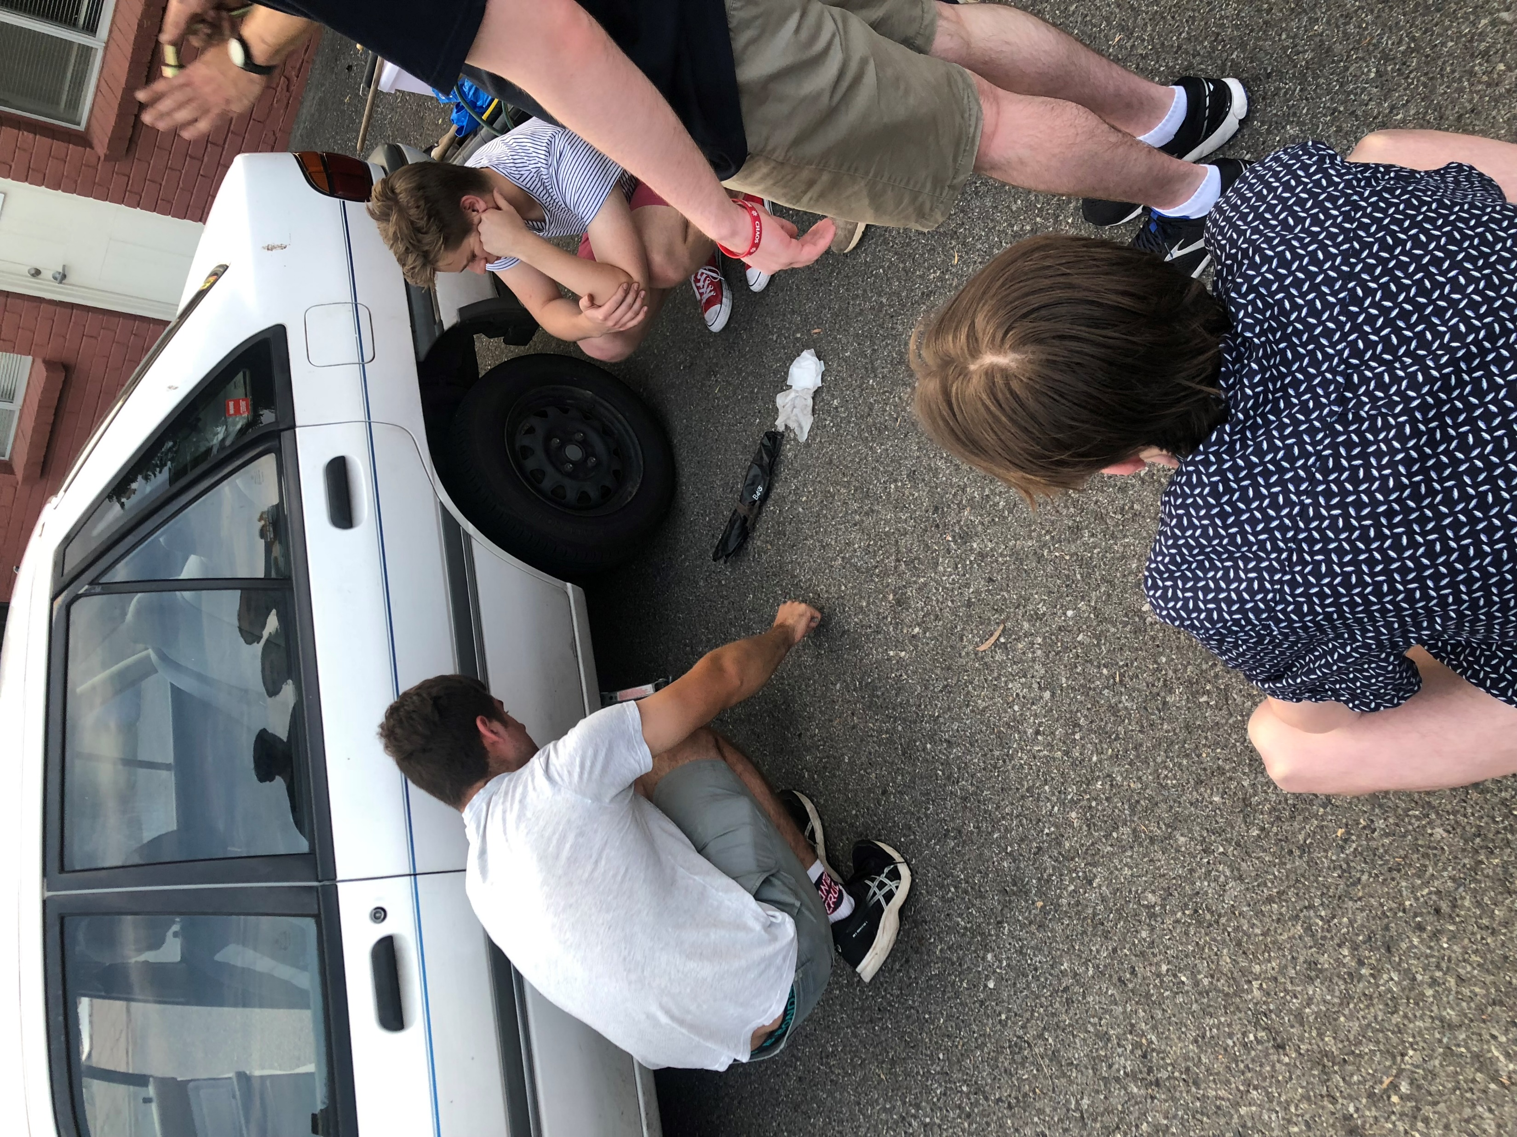
Notes:
NONI
Here’s my friend Paul on screen at the car.
He’s a regular with basic car maintenance as group members are reaching their P’s.
On the other hand, one of my co-facilitators is Elissa.
She originally trained as a hair dresser.
Our groups love her to run through hair hygiene, as well as more specific things, like up styles and ways to make hair easier.
Every group is different, but just know it’s harder to generate conversation at this age in the early stages.
It’s not you!
To get around this, we ask questions and use the “stand up/sit down/squat” technique.
I ask questions and then everyone answers accordingly.
I also use “Mexican wave/zombie/dropped” arms for when they all seem tired and we’re low on energy.
It’s funny too.
Once they’ve answered a few questions this way they relax and I’ll can then ask questions so they each get a chance to talk.
Use quirky questions such as “what subject would you eliminate from the school curriculum if you had the power to wipe it out?”
By this point they all feel at ease to answer.
And be careful which way you go around the circle.
If someone is highly anxious, go the other way, and give them time to ease in.
Or, prewarn them it’s coming their way. You might even help them!
Then, make sure to change the direction on the next question so they feel like the questions are shared out evenly.
This is a less threatening a way for everyone to get to know each other, rather than asking each person to introduce themselves.
Plus it can spark discussions and helps them realise they have a lot in common.
And of course, you and your co facilitator, can join in too.
Never sit out! Even in self defence week and car maintenance sessions we roll our sleeves up and get in and do it too!
Don’t be scared to stuff up or look weird. It’s half the fun and the group will love you for being real!
Say something about these images on screen …

Slide 26
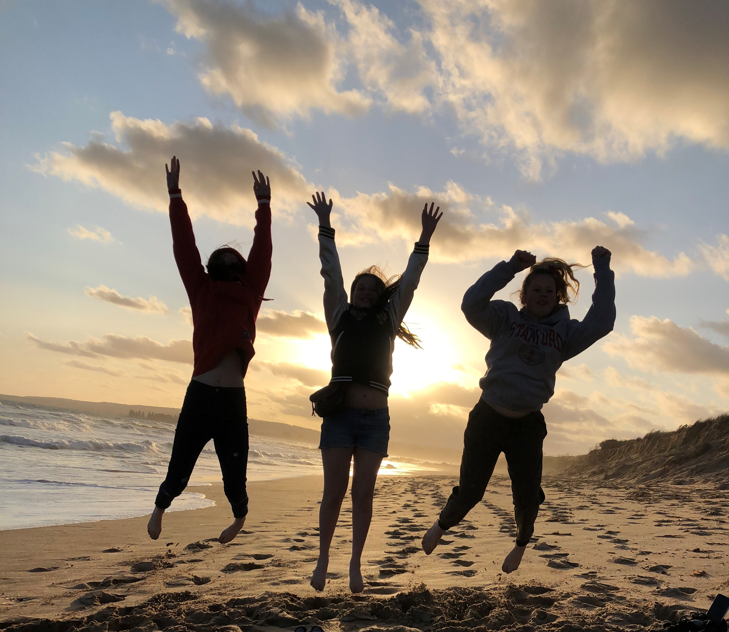
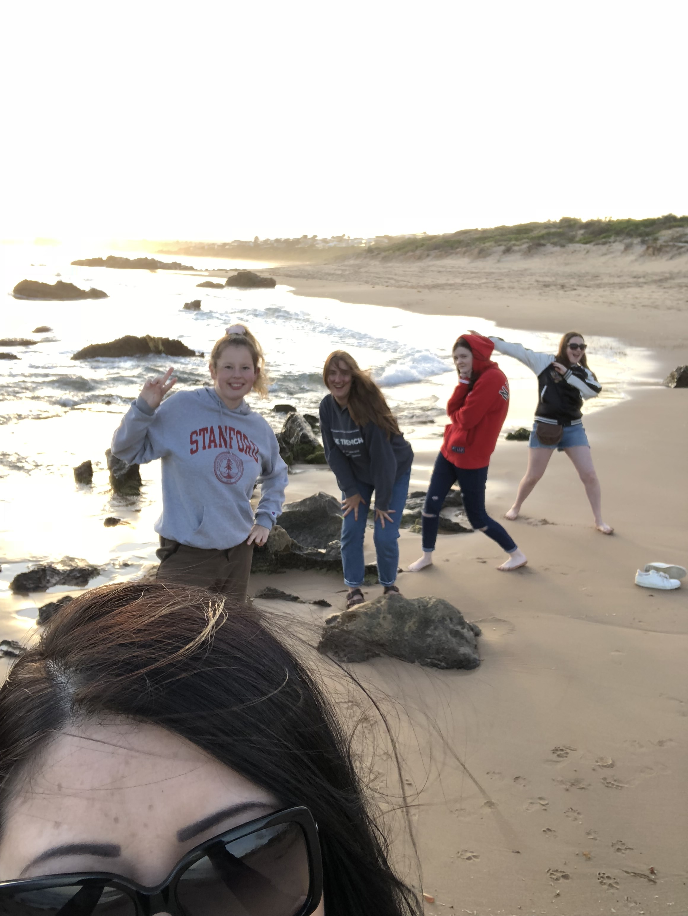
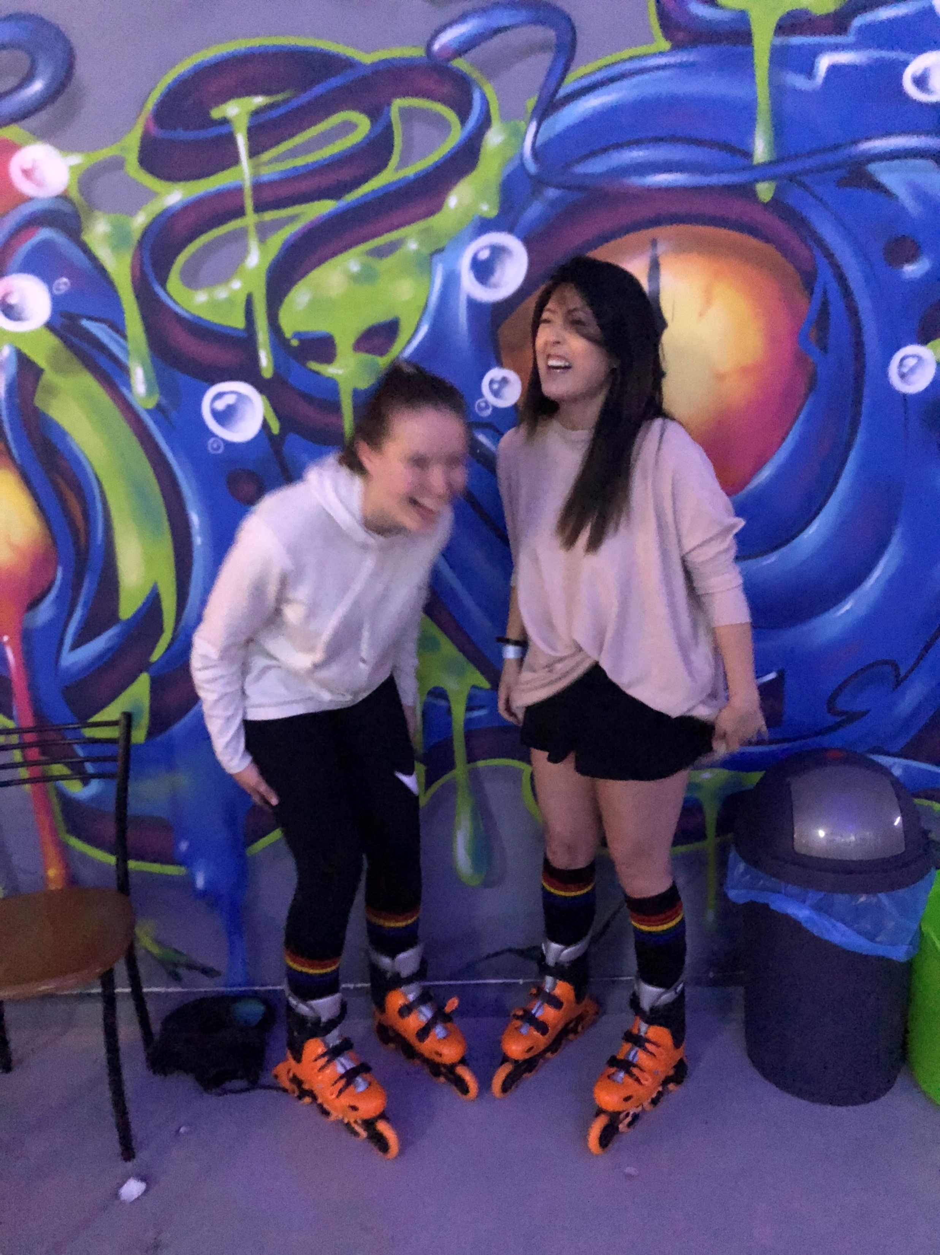
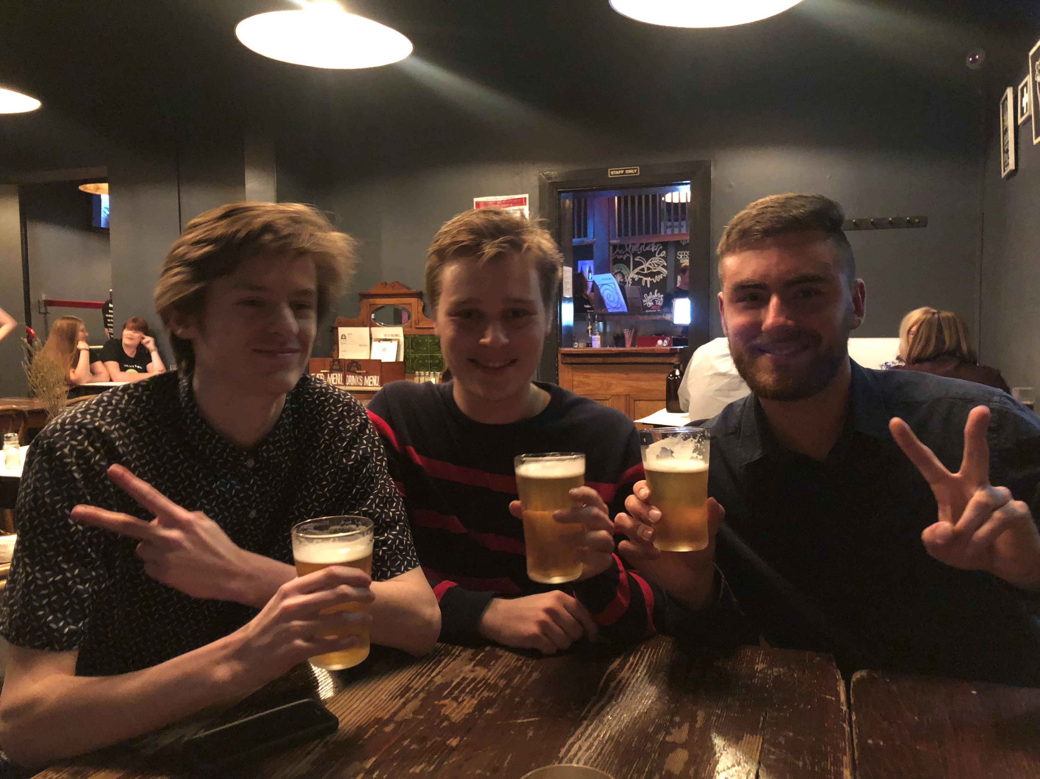
Notes:
NONI
Finish up by saying something about these images on screen, right now …
Then click on to diversity groups and holiday groups …

Slide 27

Notes:
NONI – how’s that time going? Is it 12:10?
Yes, I deliberately keep my teen groups as single sex groups.
Why? ………… explain ….
And we run diversity groups for those on a similar journey together.
In the holiday breaks, I also do other activities with some of my older groups.
We’ve done bowling and laser tag including arcade games in between, mini golf, gaming in the cinema, painting at plaster fun house, dog walks, ice cream and shopping. We also go to the beach, movies or to someone’s house.
In these holidays I’m taking a couple of groups to an escape room.
Again, always join in and be strategic in who you place together on teams or against each other.
Be smart in not choosing things that will get overly competitive!
Also, be conscious of how many are likely to come along and if the activity is too sensory taxing.
There’s a fair bit of planning that goes into doing these, but once the group has been together a while and they’re getting older, it’s easy to find success.

Slide 28

Notes:
NONI
With that said – ‘Have you any questions or comments about our TEEN and ADULT GROUPS?’

Slide 29


Notes:
MARK
Here’s Spotto! 1 of 3.
Can you spot the one the ‘odd one out’! Don’t say a word!
Once you have it, put your hand up!
<<<<<<<<<<<<CLICK to reveal it >>>>>>>>>>>>>>>

Slide 30
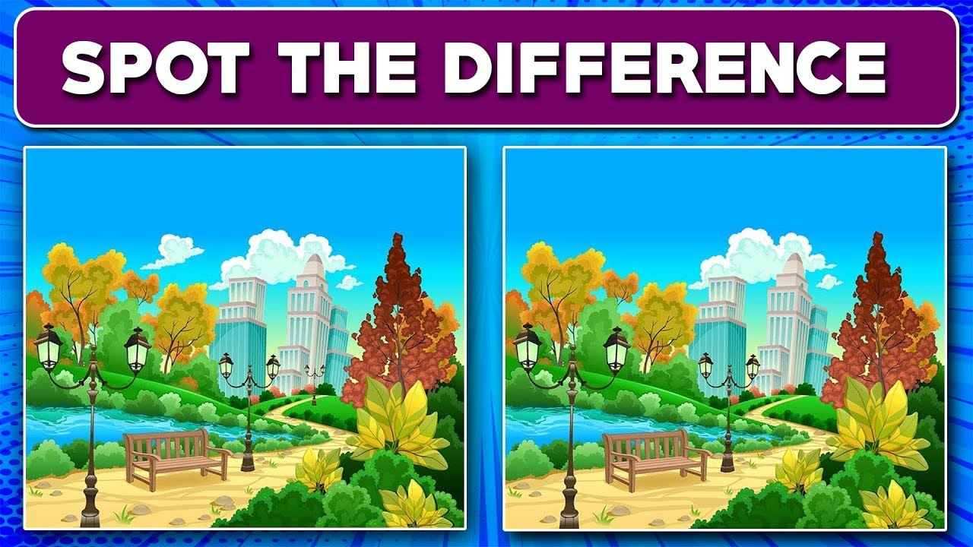
5 differences
Notes:
MARK
Can you spot 5 differences between these 2 images?
Once you have it, put your hand up!
Wait for a while …
<<<<<<<<<<<<CLICK to reveal it >>>>>>>>>>>>>>>

Slide 31

Can you spot 6 differences? Be warned some are tiny
Notes:
MARK
Last one!
Can you spot the 6 differences between the 2 images?
A couple are very small differences!!!!
Work with your partner to find them!
Wait for a while …
CLICK to reveal it.

Slide 32
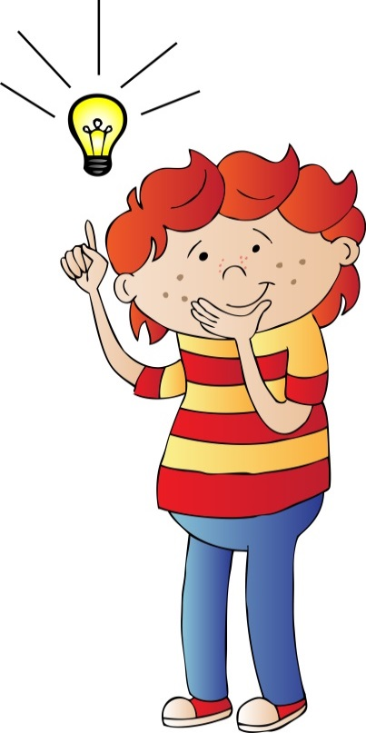
What’s the Buzz? for EARLY LEARNERS
Lesson 13: Speaking up (learning to be assertive)
Archie’s story; “Keep it a secret”
Notes:
MARK
For a change in pace, let’s hop into Lesson 13 together from the EARLY LEARNERS program.
Speaking up (learning to be assertive)

Slide 33

What’s the Buzz? for EARLY LEARNERS
Lesson 13: Saying No (being assertive)
Archie’s story - “Keep it a secret”
1. What’s the Buzz – setting the scene
Let’s start with Archie’s story - “Keep it a secret”
2. Show me the Buzz - performing
‘Role-play’ as Angry Bulls or Scared Squeaky Mice or Wise Owls
3. Do you know the Buzz? - intellectualising
‘What if’ questions; which animal solved the problem?
‘Thumbs up, and ‘thumbs down’ quiz: a secret or a surprise?
4. The Buzz - integrating the learned skills
‘Draw me if you can’
5. Goodbye Buzz - finishing Archie’s story
We start here!
Notes:
The ‘Safety Aware’ App is a gamechanger for child safety.
At last, an appealing, personalised and consistent approach to build a secure foundation knowledge so children learn how to stay safe in every situation.
Schools must commit to this. Everything is organised; from content to delivery that fits seamlessly into current curriculum. It’s ready for teachers to use.
Nothing is more protective than the opportunity for children to share and discuss this knowledge in class, during guided conversations that consolidate the learning.
The ‘Safety Aware’ App offers real cultural change.
While the App’s unique delivery teaches children to stay safe and speak up,
Key social principles from this lesson are;
Teaching children how to have ‘the harder conversations’.
Coaching them how-to say, "No“ - respectfully and assertively - when something isn’t right or doesn't feel right.
That secrets that are forced, or may hurt another, should never be kept

Slide 34
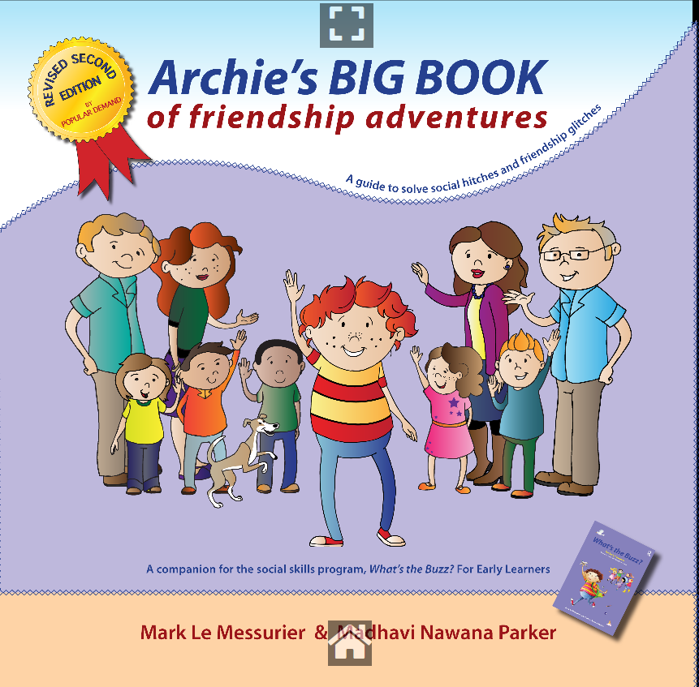
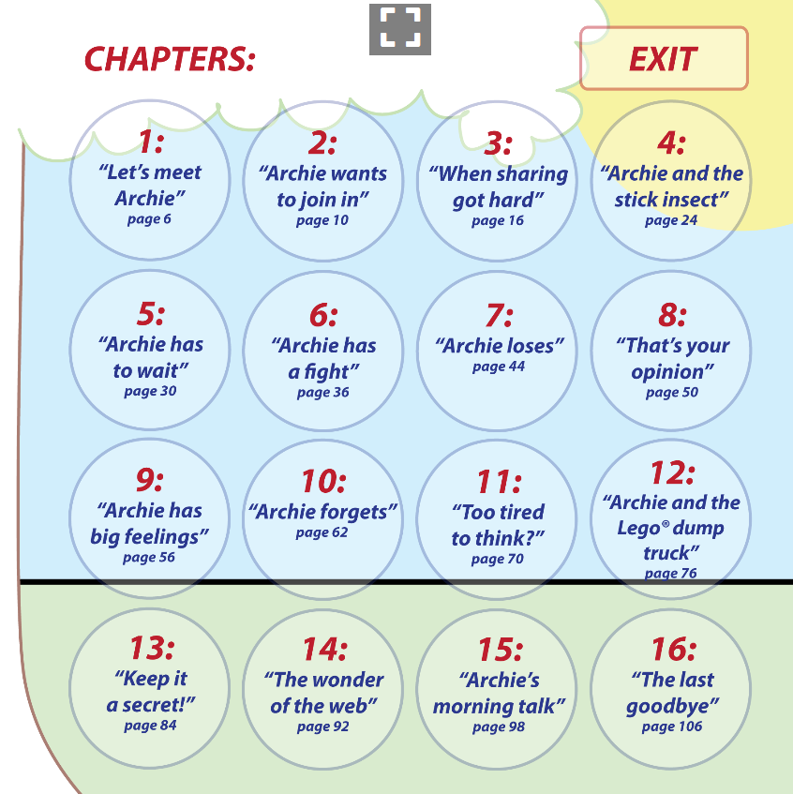
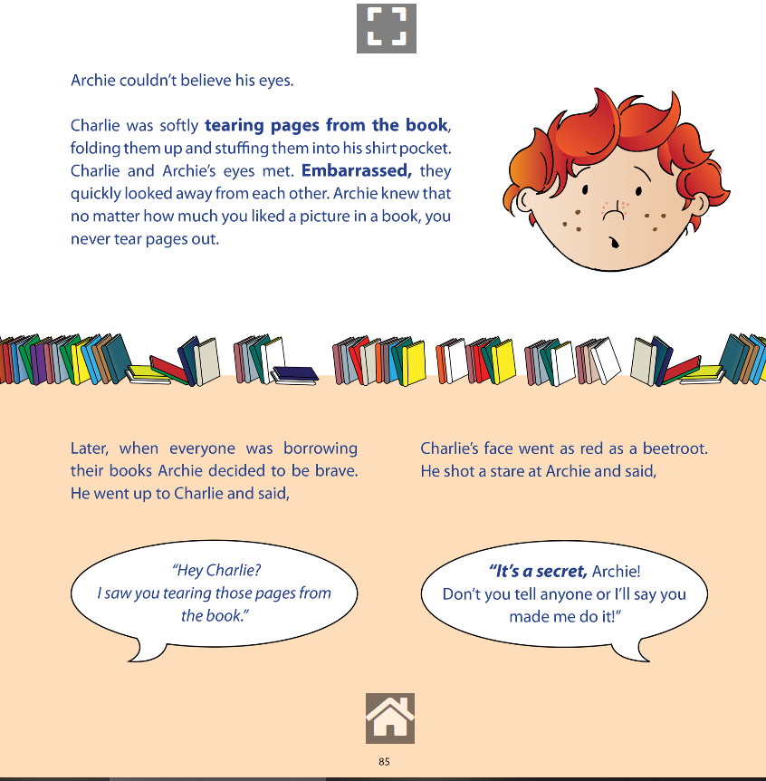
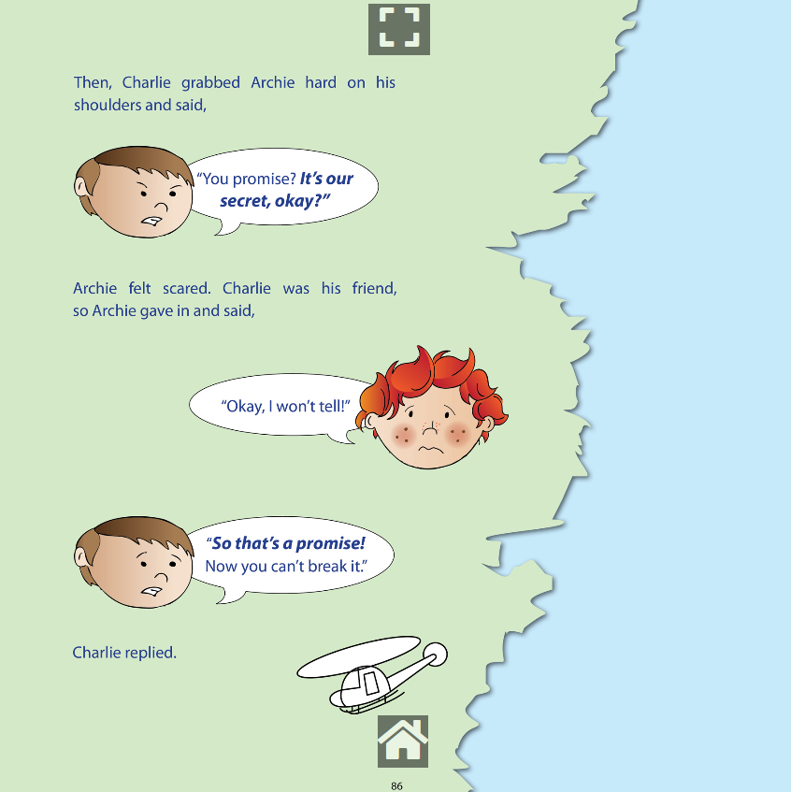
Notes:
MARK
As you’ve gathered, there is an ‘Archie’s BIG BOOK of Friendship Adventures’ available.
We have also converted this book to a digital format that you can read from screen just as we’re about to do!

Slide 35
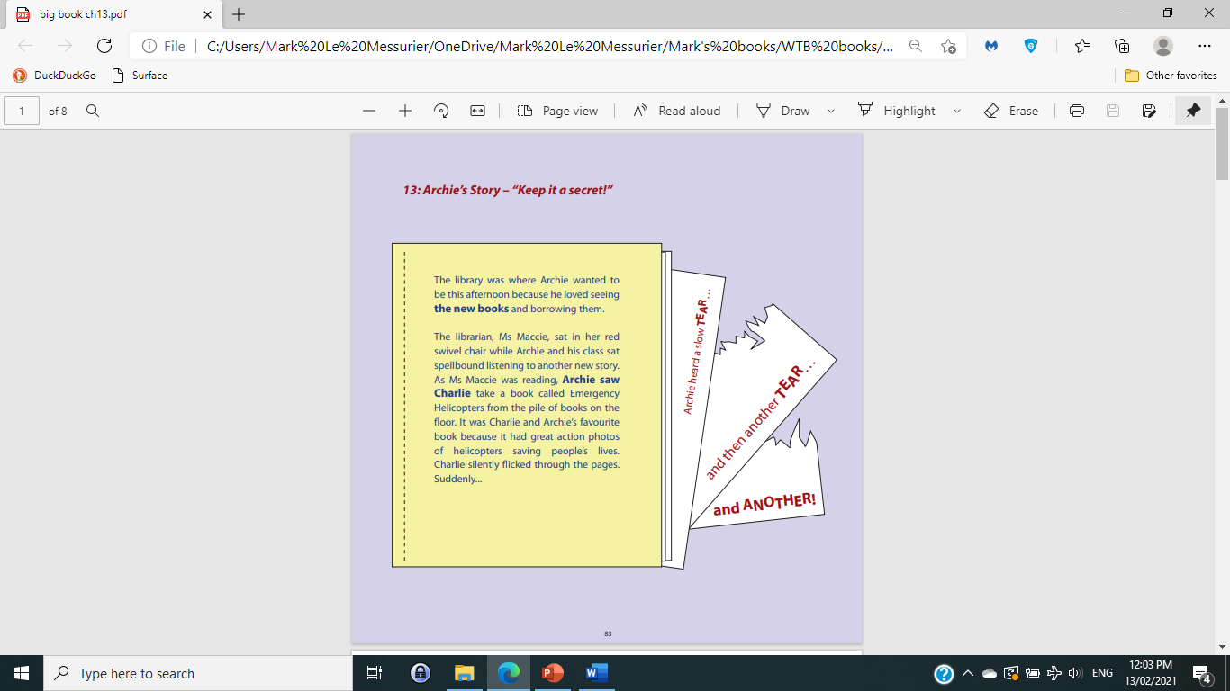
Notes:
NONI

Slide 36
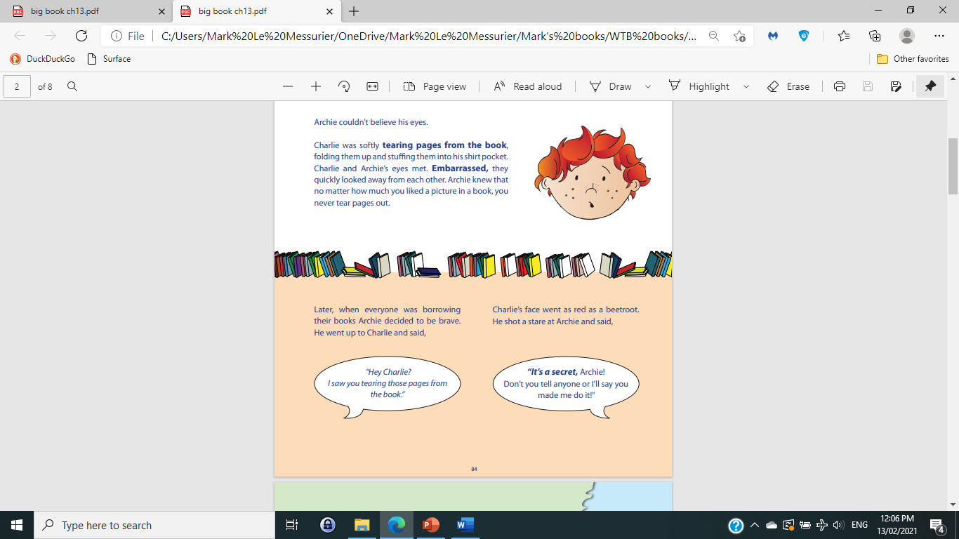
Notes:
MARK

Slide 37
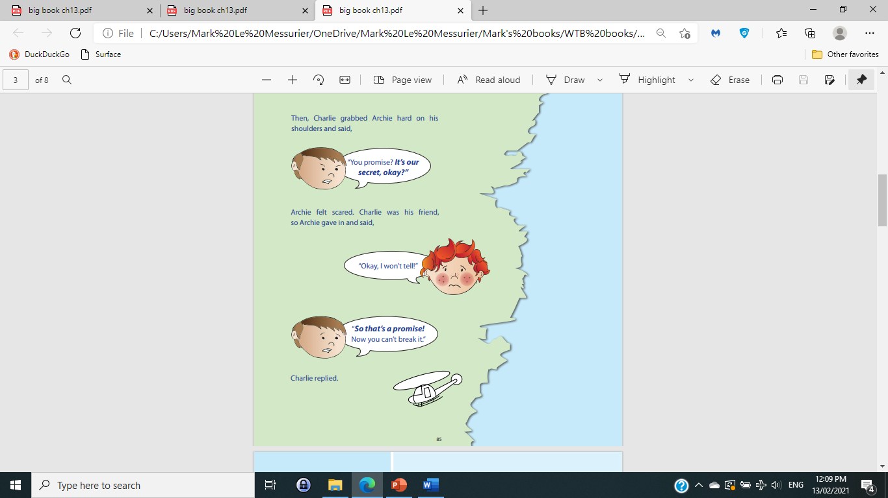
Notes:
NONI

Slide 38
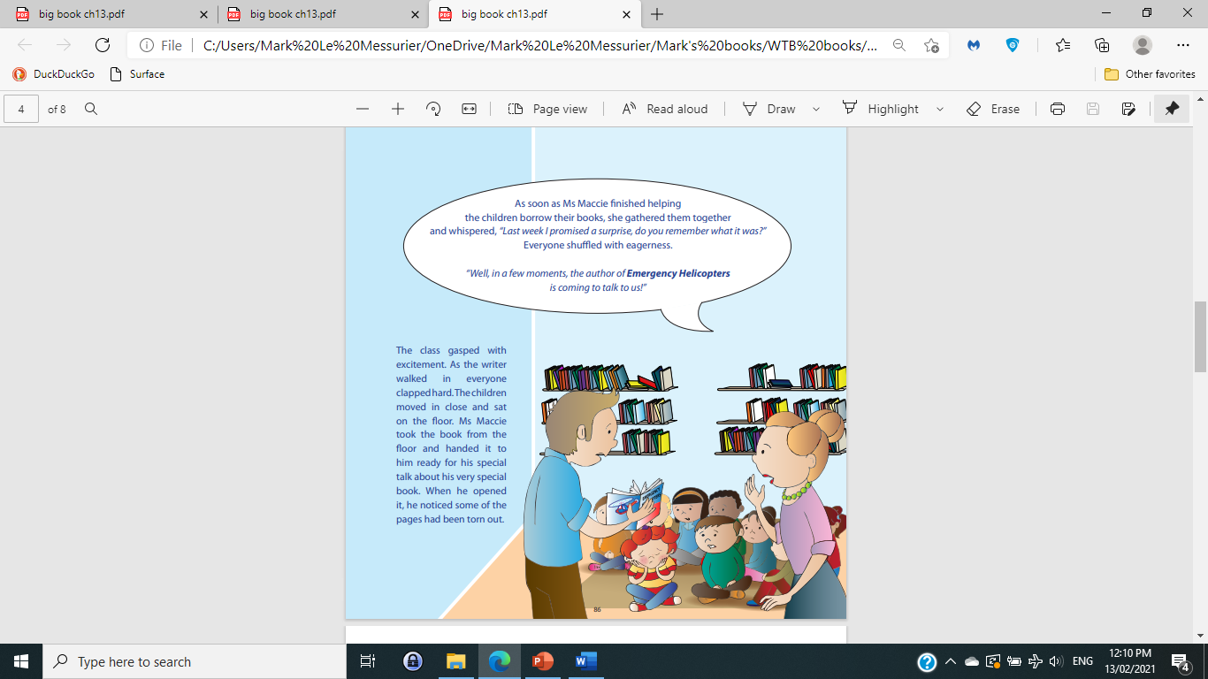
Notes:
MARK

Slide 39
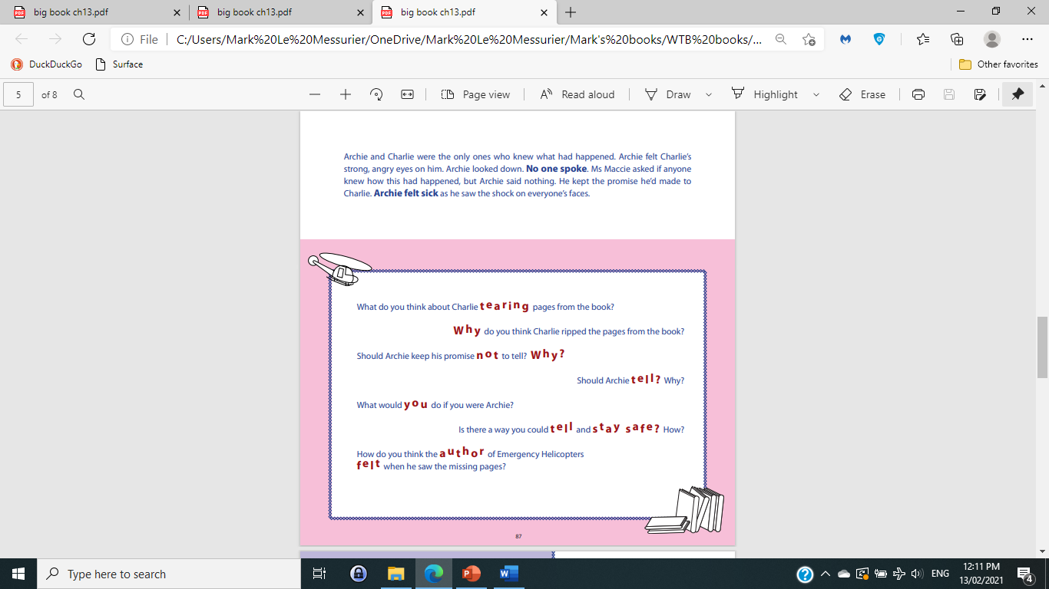
Notes:
NONI

Slide 40
What’s the Buzz? for EARLY LEARNERS
Lesson 13: Saying No (being assertive)
Archie’s story - “Keep it a secret”
1. What’s the Buzz – setting the scene
Let’s start with Archie’s story - “Keep it a secret”
2. Show me the Buzz - performing
‘Role-play’ as Angry Bulls or Scared Squeaky Mice or Wise Owls
3. Do you know the Buzz? - intellectualising
‘What if’ questions; which animal solved the problem?
‘Thumbs up, and ‘thumbs down’ quiz: a secret or a surprise?
4. The Buzz - integrating the learned skills
‘Draw me if you can’
5. Goodbye Buzz - finishing Archie’s story
We’ve moved to here
Notes:
MARK
“Tell me, what’s the secret in the story?”
“Put your hand up if you think should Archie keep it?”
“Who thinks Archie should not keep the secret?”
“Why?” Because you’d never keep a secret based on someone making you, or telling you that you must!
“What should he do?”
“Do you think Archie was brave talking to Charlie?
Me too. I think he tried to be ASSERTIVE.
He tried to talk with Charlie.

Slide 41
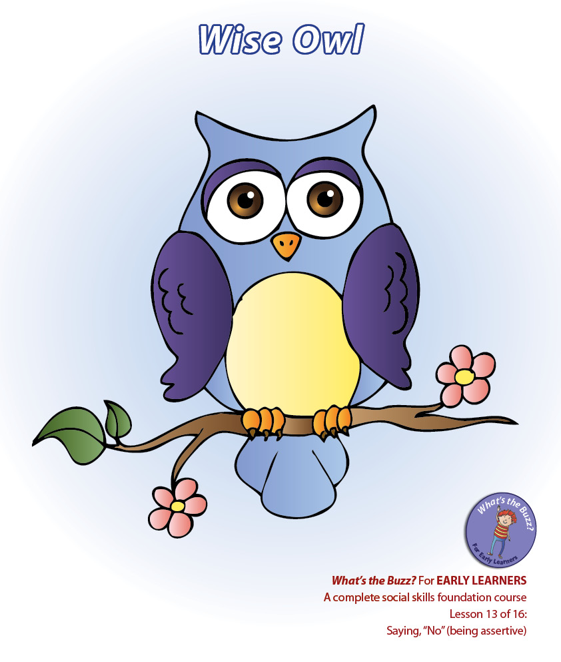
Notes:
MARK
Archie acted like a Wise Owl.
A Wise Owl is ASSERTIVE.
Wise Owl tries to talk about a problem and tries to find a way to fix it.
Wise Owl tries to use words that are honest, kind and likely to be helpful.
When Wise Owl can’t fix it, then they’ll take it to a trusted adult.
I’ll show you what a Wise Owl looks like… “hoot, hoot”
Now do it with me! Well done!
There are 2 other ways people think and behave when trying to solve tricky problems;

Slide 42
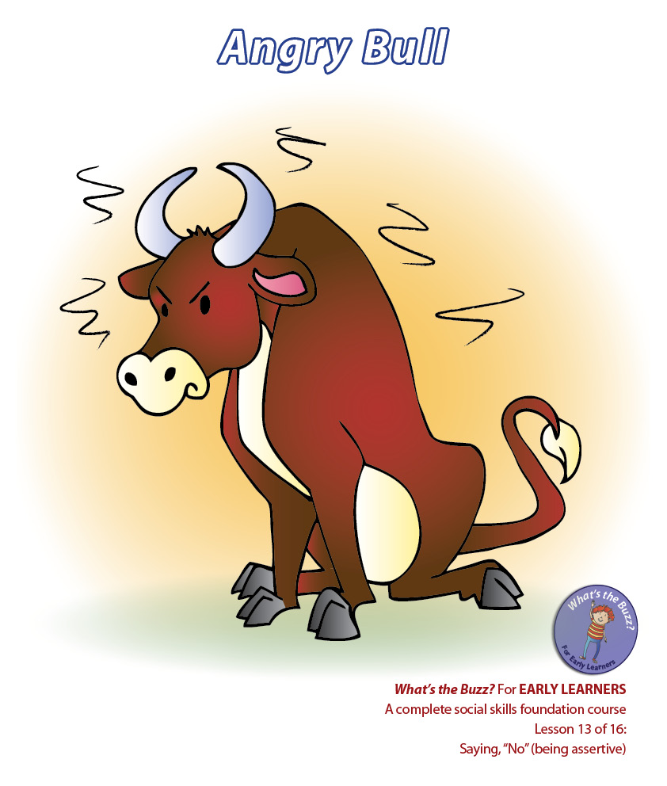
Notes:
MARK
Some become; ‘Angry Bulls’ and deal with problems by huffing, puffing, pushing and fighting to get their way.
Angry Bull will crash and bash with loud nasty words that do a lot of damage.
I’ll show you what an ‘‘Angry Bull’ looks like… “roar, roar”
Can you do it with me! Well done!

Slide 43
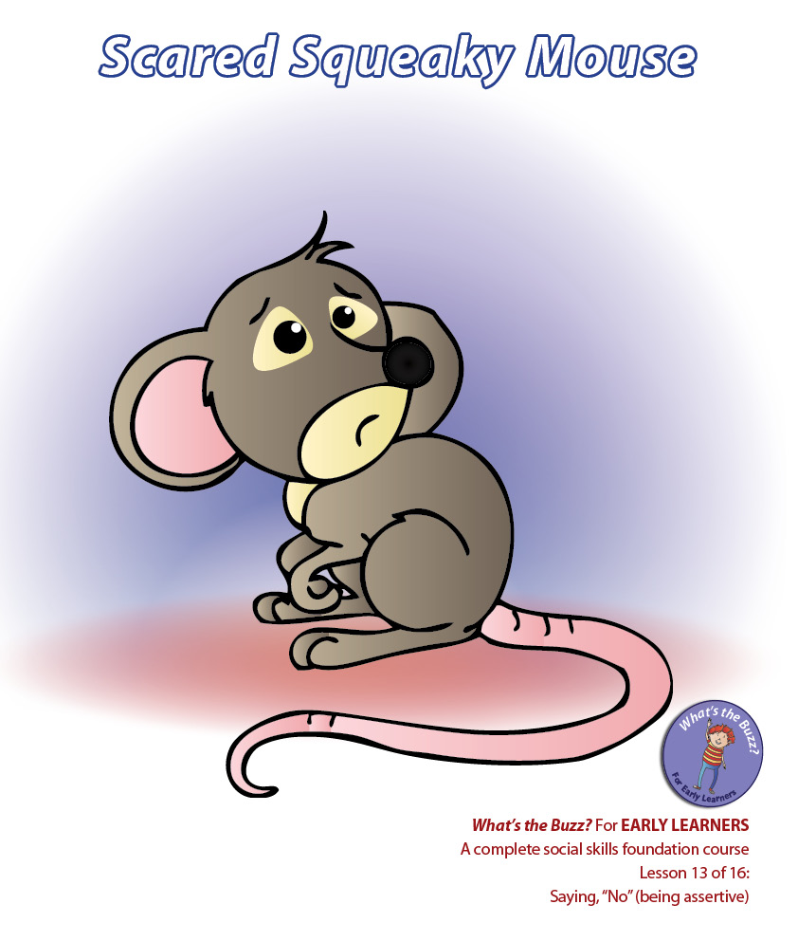
Notes:
MARK
Others don’t do anything because they behave like Scared, Squeaky Mice - they don’t face problems, don’t say much and run away with their little eyes cast down and hide shivering.
I’ll show you what a ‘Scared, Squeaky Mouse’ looks like… “squeak, squeak”
Can you do it with me! Well done!

Slide 44
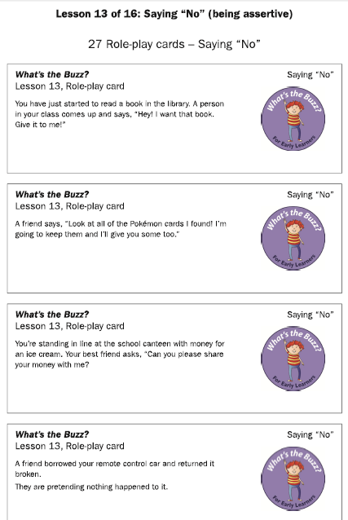
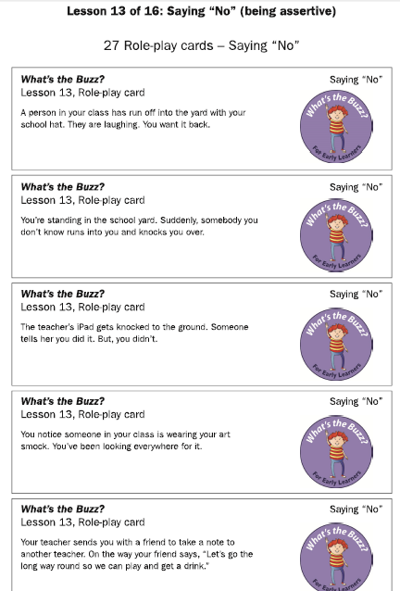
Notes:
MARK
Here are the role-play cards on screen. But, you won’t need them today as I have other ideas for you!
Today you’ll choose ONE role-play do it twice!
In your FIRST role-play you are to show how a Wise Owl would talk, behave and attempt to solve the problem.
In your SECOND role-play you are to show how either; an ‘Angry Bull’ or a ‘Scared, Squeaky Mouse’ would go about solving the problem.
Together agree on a number from, and including, 1 to 9.
Got it? Wait. Who chose number? Here is your role-play;
You have just started to read a book in the library. A person in your class comes up and says, “Hey! I want that book. Give it to me!”
A friend says, “Look at all of the Pokémon cards I found! I’m going to keep them and I’ll give you some too.”
You’re standing in line at the school canteen with money for an ice block. Your best friend asks, “Can you please share your money with me?”
A friend borrowed your remote control car and returned it broken. They are pretending nothing happened.
A person in your class has run off into the yard with your school hat. They are laughing. You want it back.
You’re standing in the school yard. Suddenly, somebody you don’t know runs into you and knocks you over.
The teacher’s iPad gets knocked to the ground. Someone tells her you did it. But, you didn’t.
You notice someone in your class is wearing your art smock. You’ve been looking everywhere for it.
Your teacher sends you with a friend to take a note to another teacher. On the way your friend says, “Let’s go the long way so we can play and get a drink?”
Return for Role-plays – remember, this is the moment to use your iPad, camera or smartphone to video or photograph each role-play. This is a wonderful way to reinforce the key social principles contained within each session. Add their images with captions to the big book, or add the children’s videos to a lesson by lesson ‘role-play video diary’. This is such an engaging way to re-experience and strengthen the key social principle from each lesson.

Slide 45
What’s the Buzz? for EARLY LEARNERS
Lesson 13: Saying No (being assertive)
Archie’s story - “Keep it a secret”
1. What’s the Buzz – setting the scene
Let’s start with Archie’s story - “Keep it a secret”
2. Show me the Buzz - performing
‘Role-play’ as Angry Bulls or Scared Squeaky Mice or Wise Owls
3. Do you know the Buzz? - intellectualising
‘What if’ questions; which animal solved the problem?
4. The Buzz - integrating the learned skills
‘Draw me if you can’
5. Goodbye Buzz - finishing Archie’s story
Here now!
Notes:
NONI
3. Do you know the Buzz?
This is our fast-moving question time.
It consolidates the lesson and helps you gauge how your students have grasped the key social principles.
So, let’s play - ‘Bulls, Scared, Squeaky Mice or Owls’ – right now
This is a silent game.
I’ll read out some small stories.
Your task is to listen and work out which animal most likely solved the problem – Angry Bull, Scared, Squeaky Mouse, or Wise Owl.
Here’s the twist - instead of putting their hands up or calling out the animal name, they must move silently around the room acting like that animal. As they do, walk between the children naming their animal so they can hear you tallying up the animals!
Robert’s brother fell into him, so Robert smashed his brother’s Lego tower. Which animal was Robert thinking as?
Louise wiped up the milk she spilled over the floor and poured another drink. Which animal was Louise thinking as?
Sally saw Emma put her new ruler in her schoolbag, but she never asked for it back. Which animal was Sally thinking as?
Sally saw Emma take her new ruler and put it in her schoolbag, and she politely asked for it back. Which animal was Emma thinking as?
Max hid from Joshua every playtime because he felt scared. Which animal was Max thinking as?
Oliver couldn’t do his work so he put his hand up, waited and asked his teacher for help. Which animal was Oliver thinking as?
Suzy snatched the dice from Alice when it was her turn to spin. Which animal was Suzy thinking as?
Suzy snatched the dice from Alice when it was her turn to spin. Alice said, “Careful, Suzy, no need to snatch.” Which animal was Alice thinking as?
Lucy was all alone in the playground so she went and asked Robert if he would like to play with her. Which animal was Lucy thinking as?

Slide 46
What’s the Buzz? for EARLY LEARNERS
Lesson 13: Saying No (being assertive)
Archie’s story - “Keep it a secret”
1. What’s the Buzz – setting the scene
Let’s start with Archie’s story - “Keep it a secret”
2. Show me the Buzz - performing
‘Role-play’ as Angry Bulls or Scared Squeaky Mice or Wise Owls
3. Do you know the Buzz? - intellectualising
‘What if’ questions; which animal solved the problem
4. The Buzz - integrating the learned skills
‘Draw me if you can’
5. Goodbye Buzz - finishing Archie’s story
Almost done
Notes:
NONI
Part 4 – is ‘The Buzz’
This section gives participants a chance to play games that help strengthen their relationship and the skills central to the lesson.

Slide 47

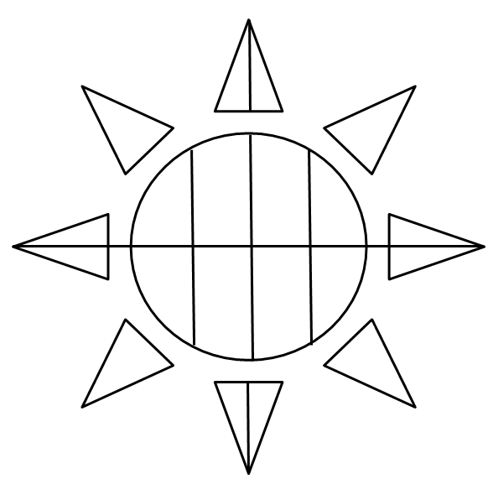
This ‘Buzz’ game is – draw me if you can!
‘Drawers’ must keep their backs to the screen, eyes at their page, listen to the ‘communicator’ and draw.
The ‘communicator’ can talk as much as they like to help the ‘drawer’ draw what’s on the screen. ‘Communicators’ can even stop and re-start the ‘drawer’!
‘Communicators’ must also keep their hands behind their backs
Work in pairs.
One is to be a ‘drawer’.
The other is the ‘communicator’.
‘Communicators’ may look at the screen, but the ‘drawer’ can’t.
Notes:
NONI
Are you ready!
Here’s how to play, Draw me if you can!
Read from screen
CLICK – image of drawing appears on screen.
STOP – allow them to both look, assess, laugh and chat

Slide 48
What’s the Buzz? for EARLY LEARNERS
Lesson 13: Saying No (being assertive)
Archie’s story - “Keep it a secret”
1. What’s the Buzz – setting the scene
Let’s start with Archie’s story - “Keep it a secret”
2. Show me the Buzz - performing
‘Role-play’ as Angry Bulls or Scared Squeaky Mice or Wise Owls
3. Do you know the Buzz? - intellectualising
‘What if’ questions; which animal solved the problem?
4. The Buzz - integrating the learned skills
‘Draw me if you can’
5. Goodbye Buzz - finishing Archie’s story
This is it!
Notes:
MARK
As you can see - gesture to screen - we’ve arrived at the end of the lesson.
So, let’s finish Archie’s story and find out what he did…

Slide 49
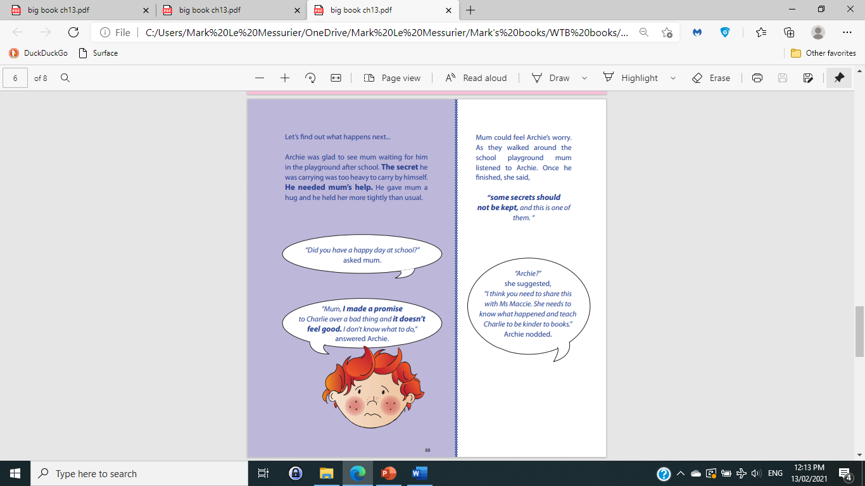
Notes:
MARK and NONI to share the reading

Slide 50
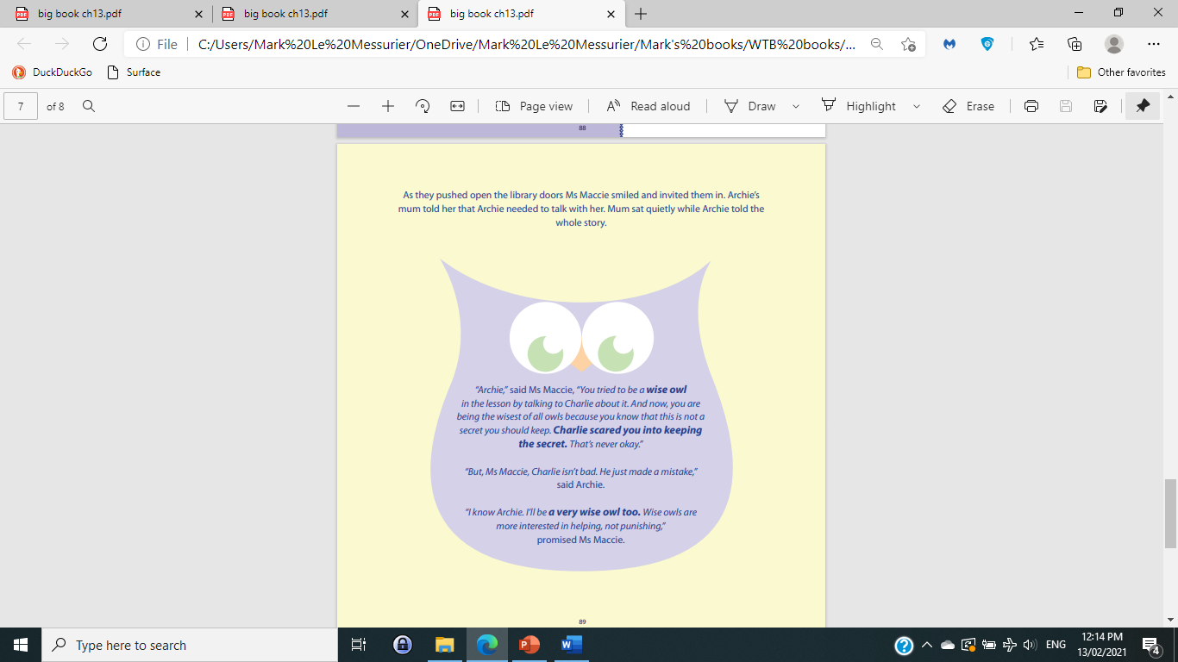
Notes:
MARK

Slide 51
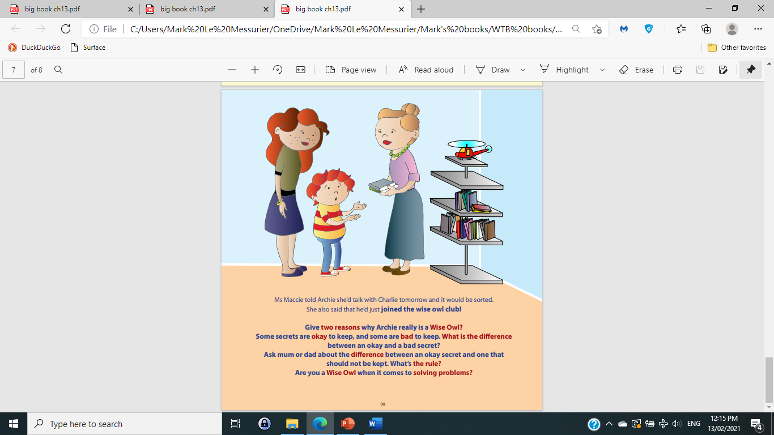
Notes:
NONI

Slide 52

Notes:
MARK and NONI
Thank you for persevering with us over these 2 back to back sessions.
We hope that you can see, What’s the Buzz? offers a good way to set up better connections WITH students, and BETWEEN students.
Our advice is to take the leap of faith!
What’s the Buzz? can be broken down into the smallest of chunks, or used lesson by lesson.
Your students will love it as you work your magic, and put your own stamp on it!
Any comments or questions?

Slide 53

Notes:
Lunch

